Slide 1
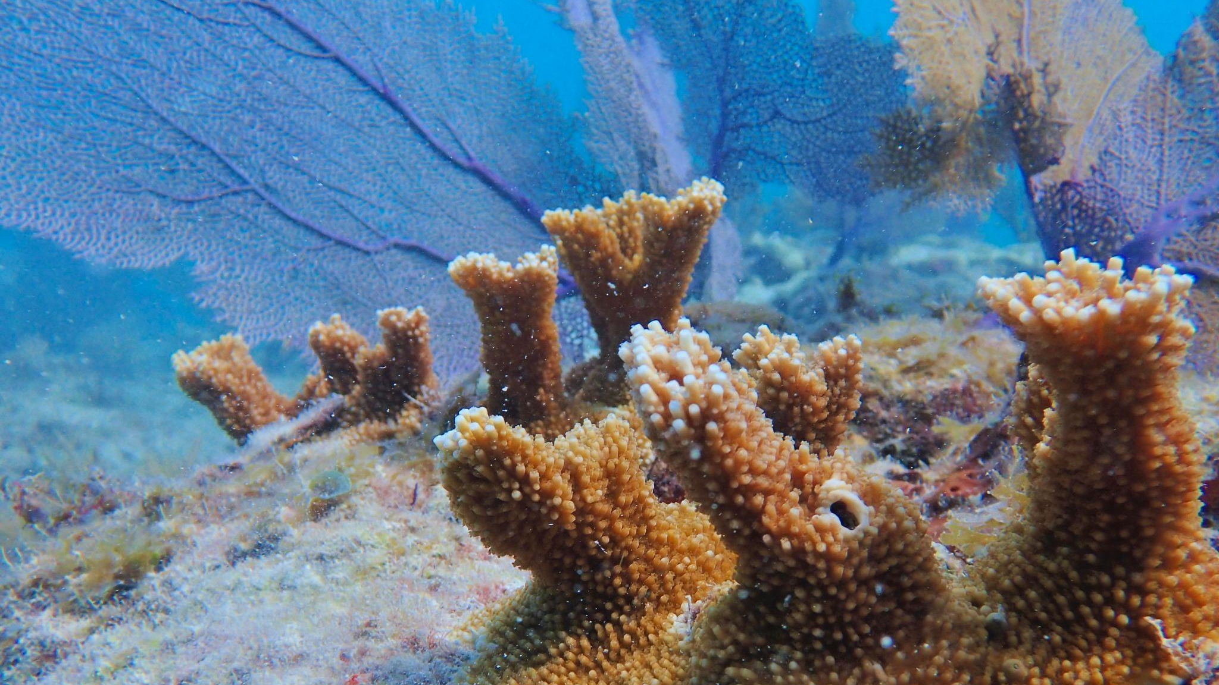
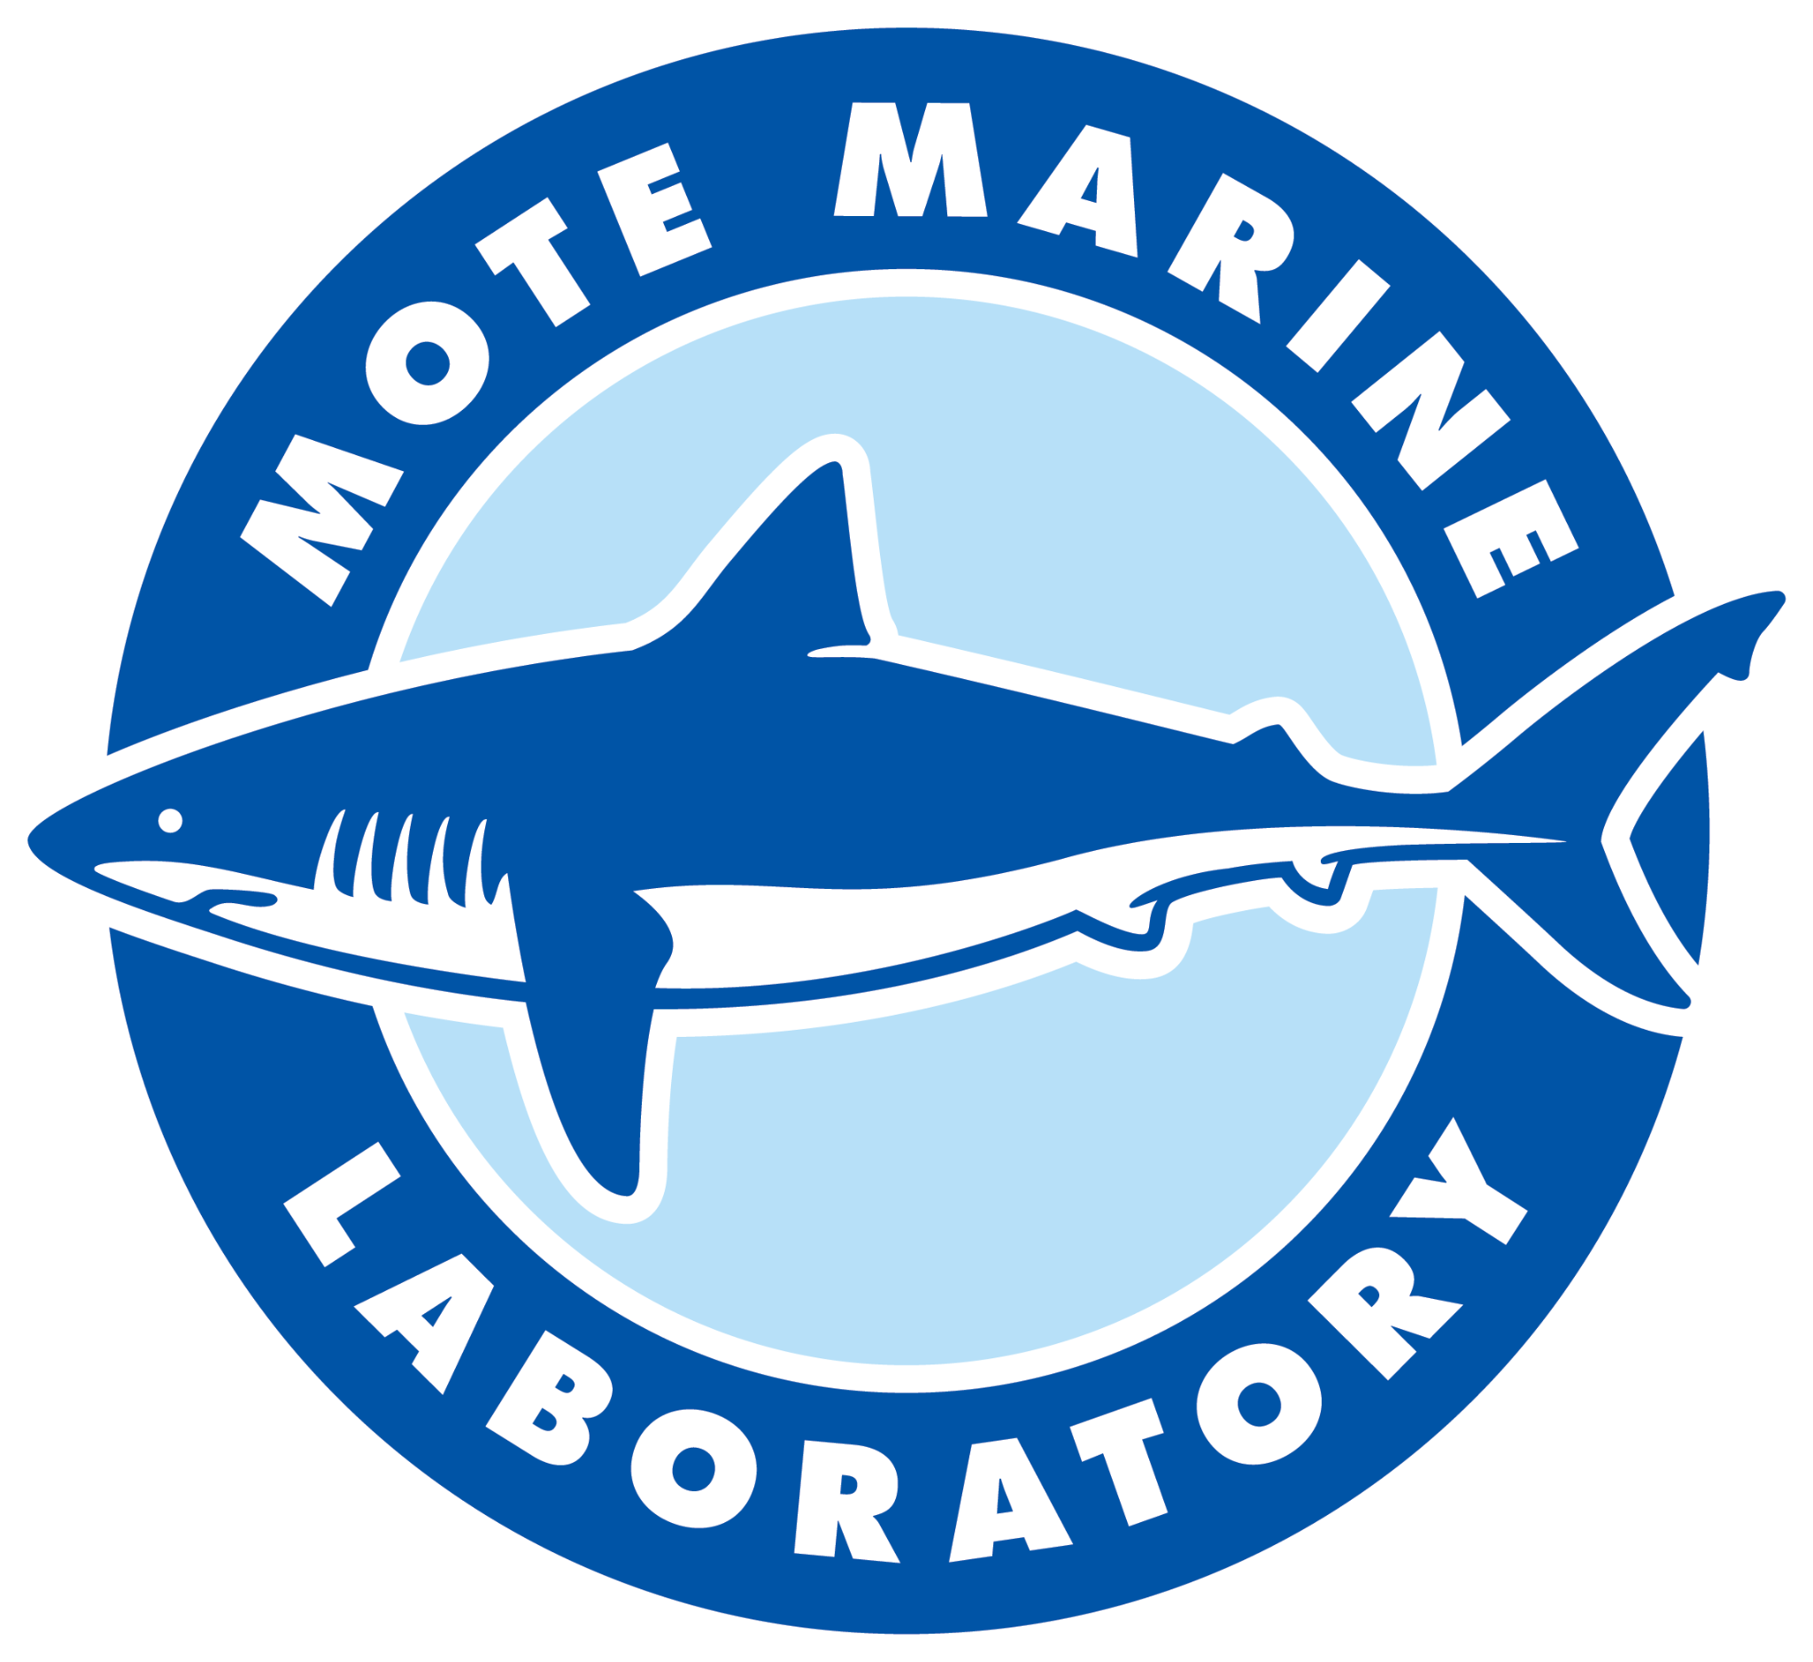

Assessment of Benthic Ecosystem Changes Post-Outplanting Using Structure-from-Motion (SfM) Photogrammetry
Authors: Ian Combs; Gabrielle D’Alonzo*; Erinn Muller; Erich Bartels; Jason Spadaro
AMLC
May 23, 2023
Mote’s International Center
for Coral Reef Research &
Restoration

Slide 2
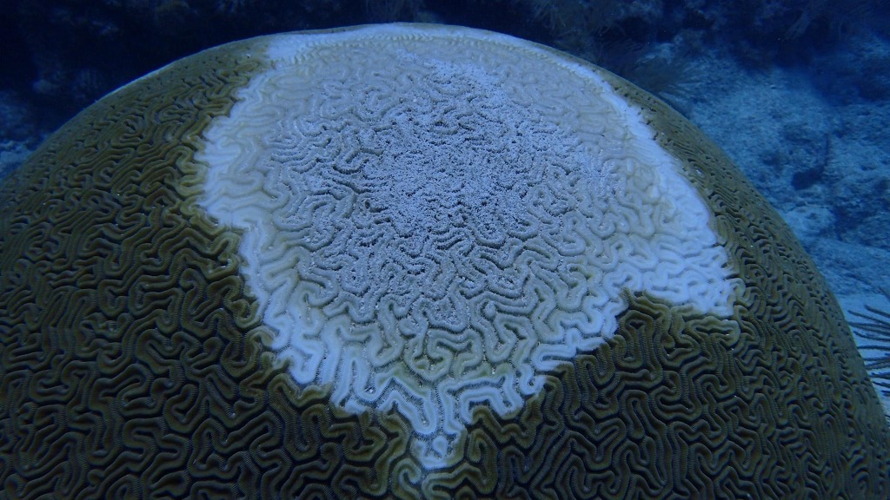
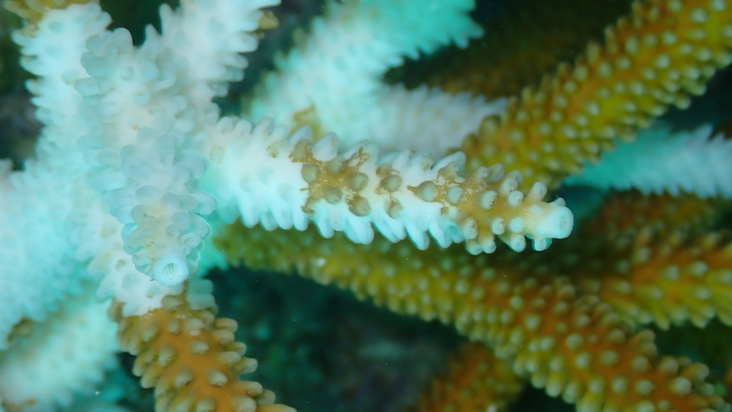
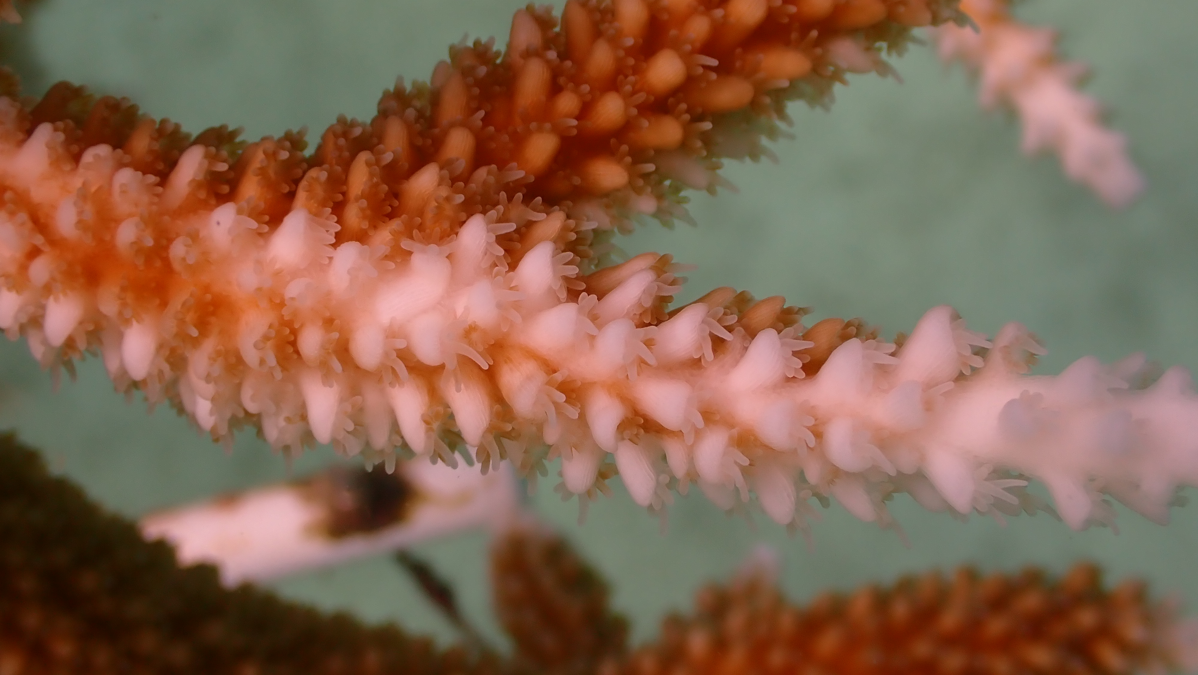
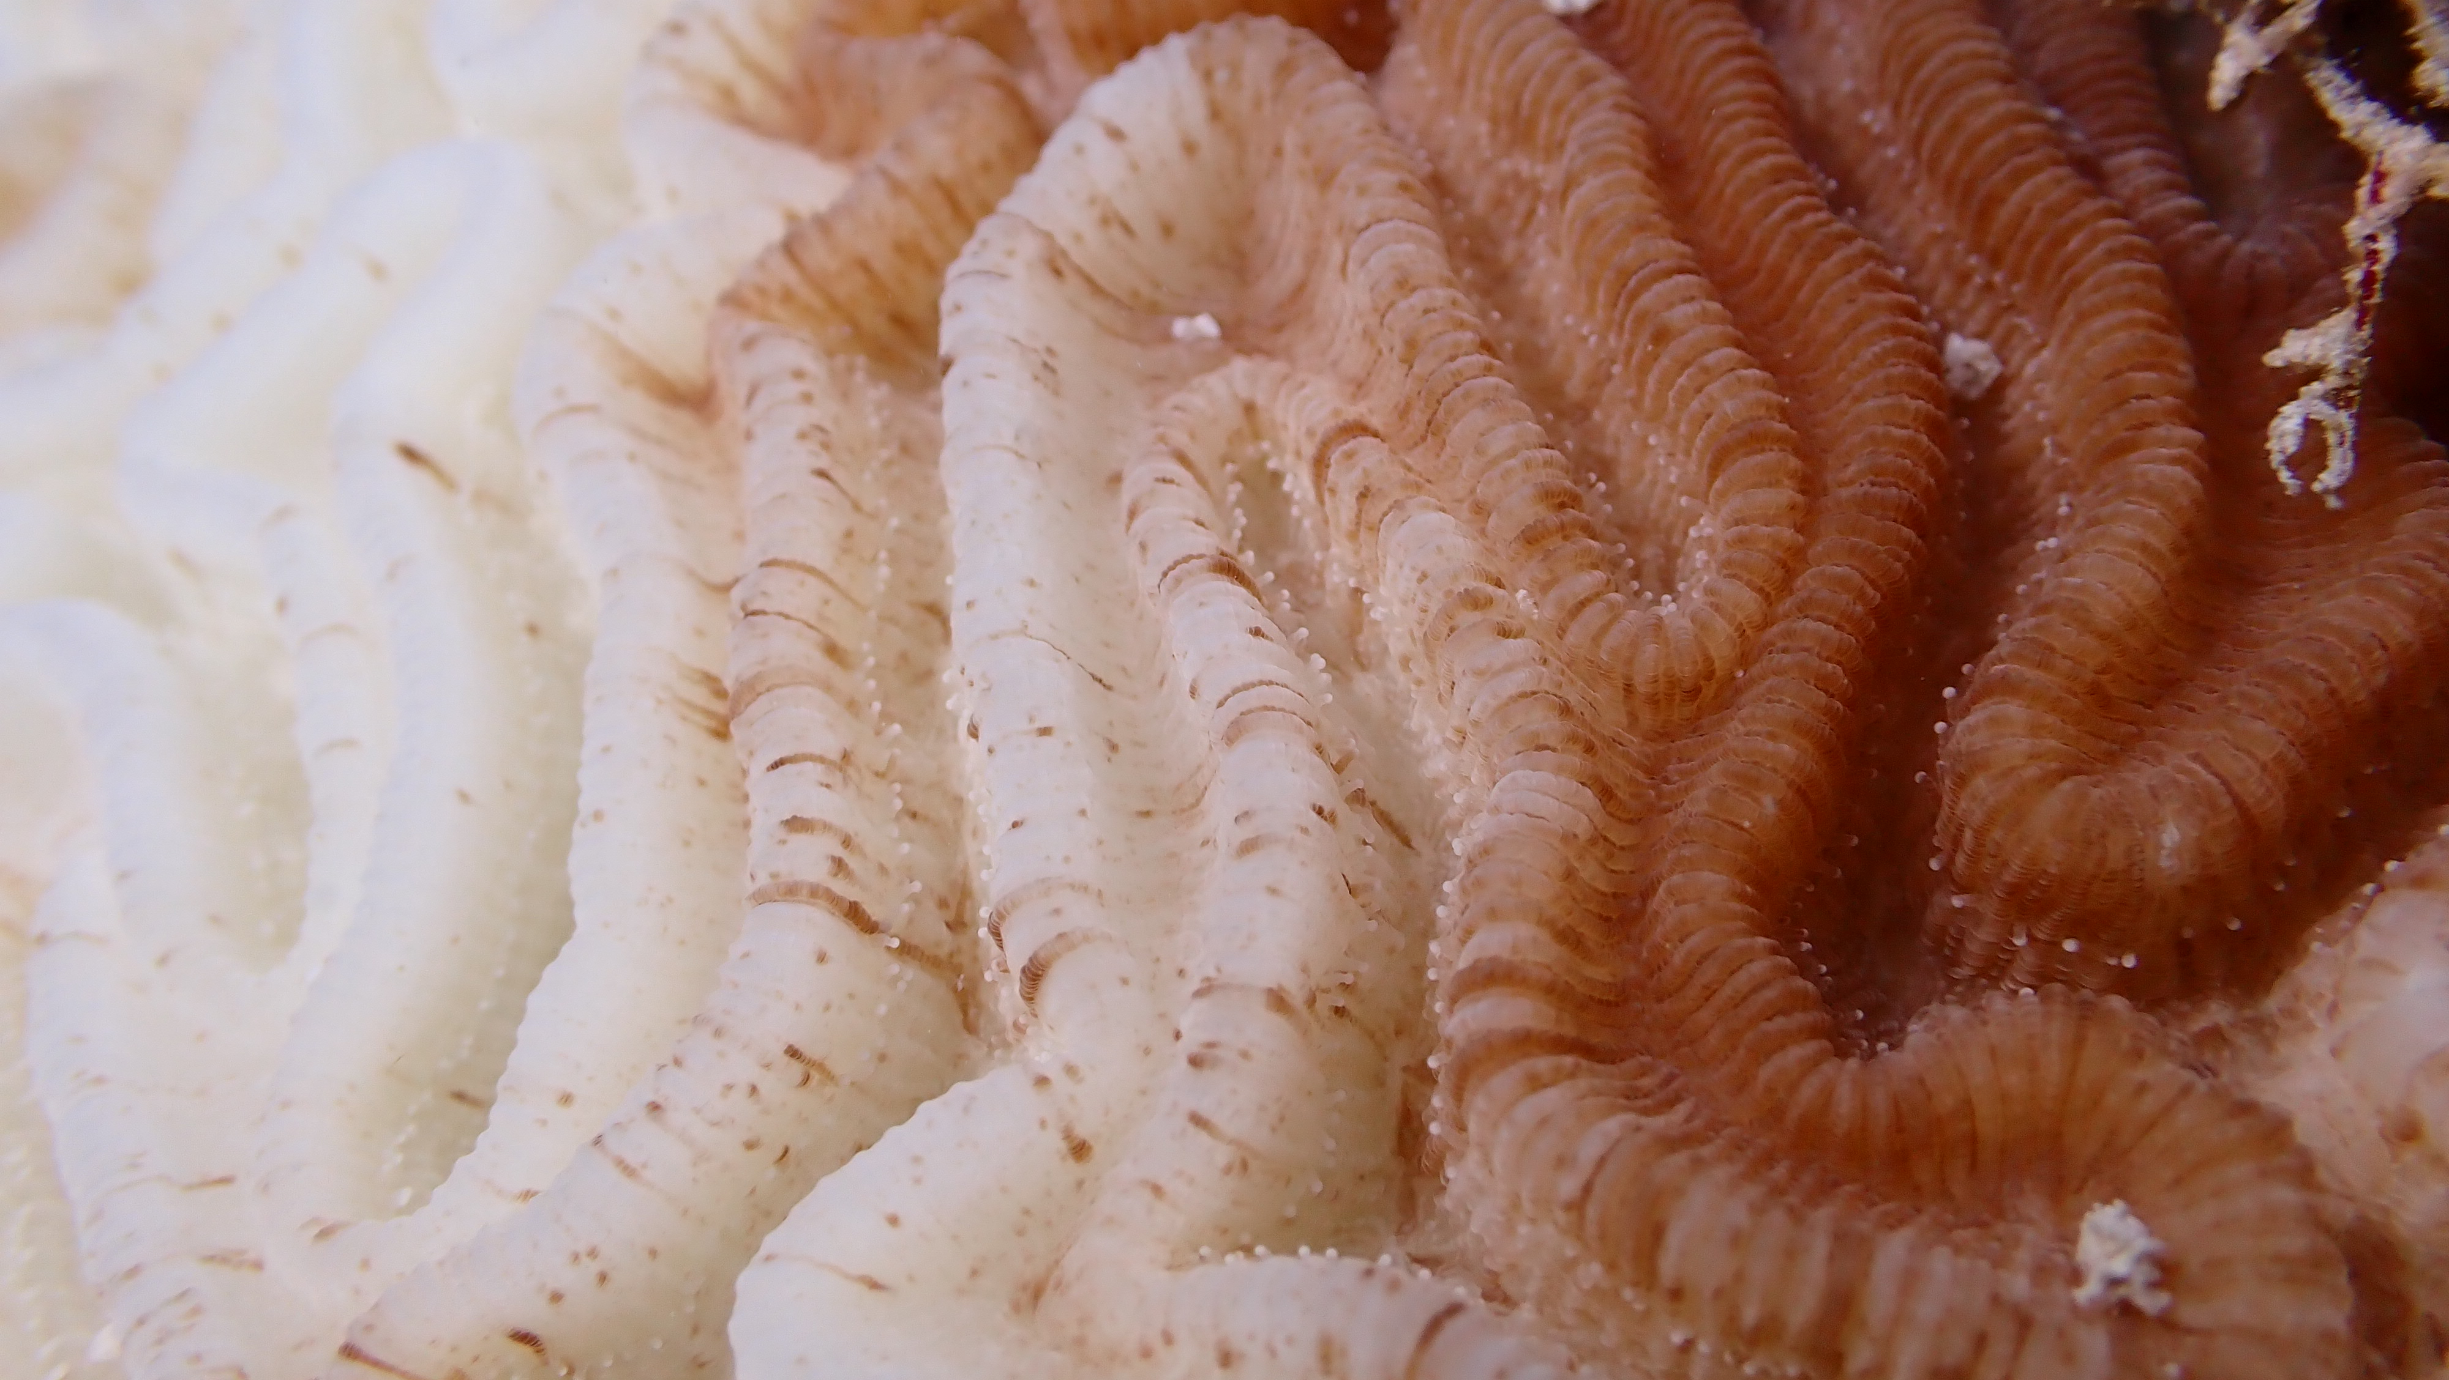
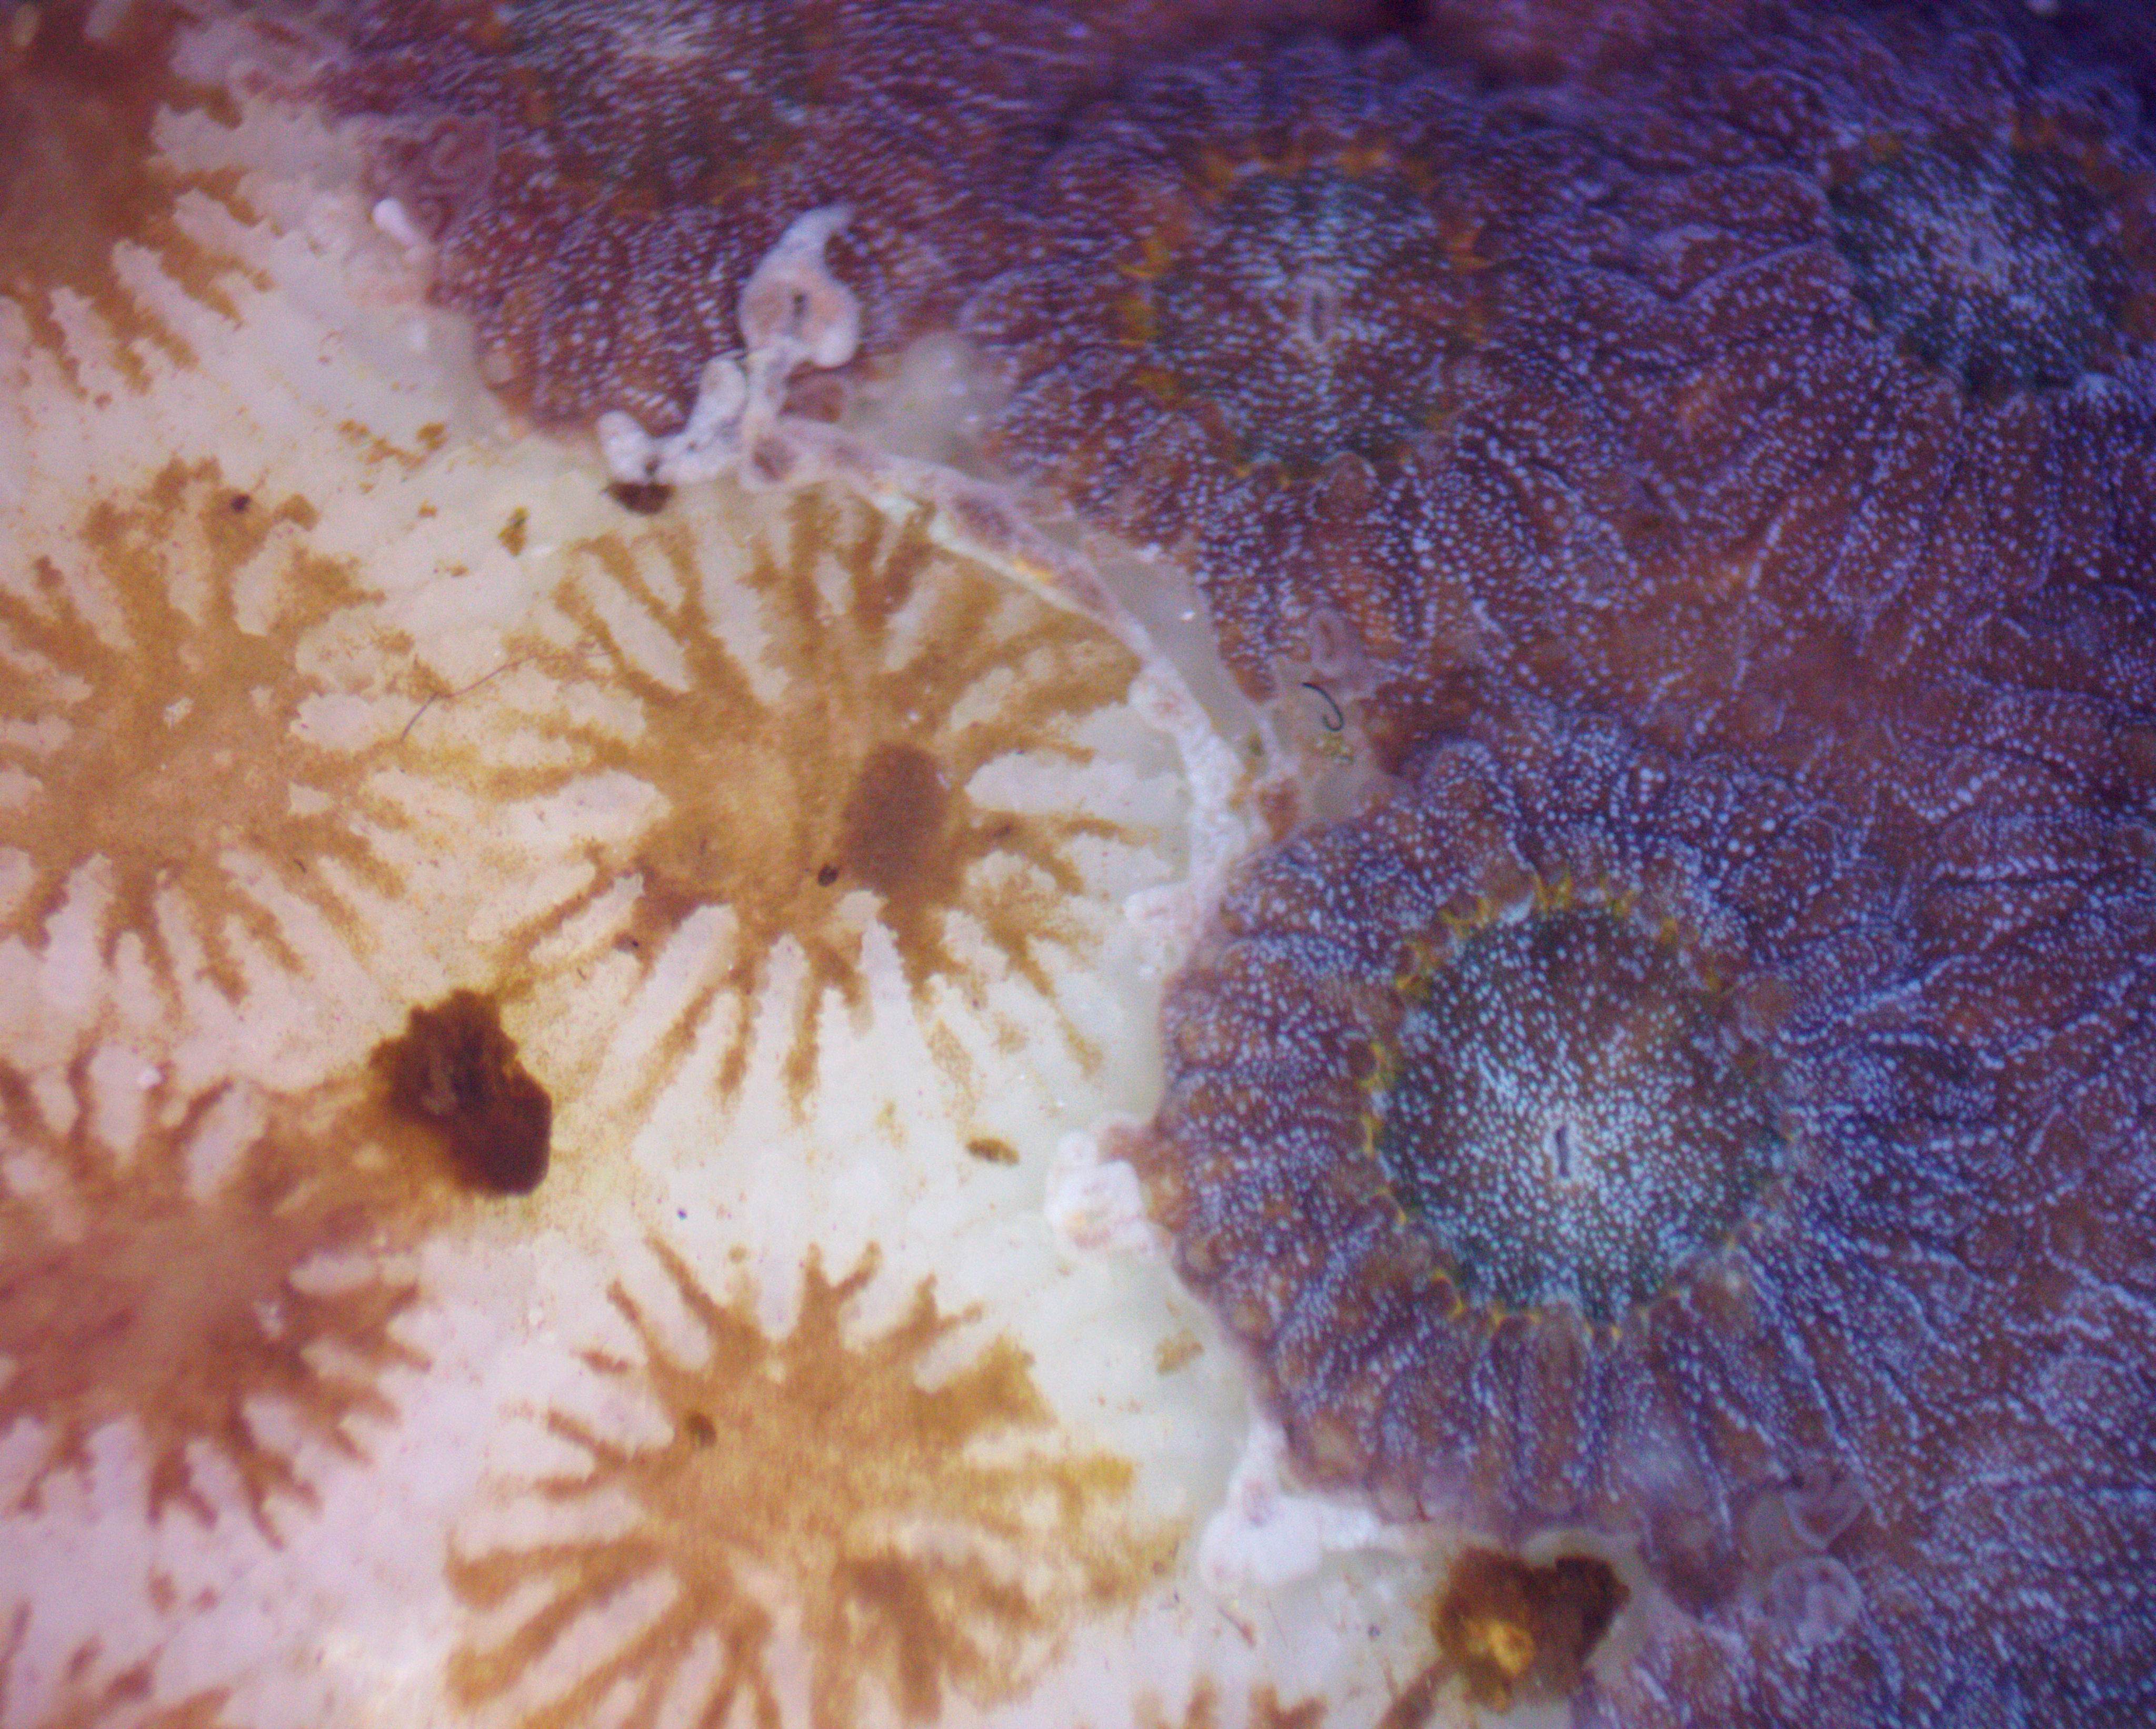
Introduction
Numerous factors severely affecting the health and diversity of the Florida’s Coral Reef
Photo credit: Zachary Craig & Samantha Simpson
Notes:
As we are all well aware, coral reefs globally are in decline, FCR is no different
Some of the major contributors: disease, heat stress(bleaching), competition for space, predation

Slide 3
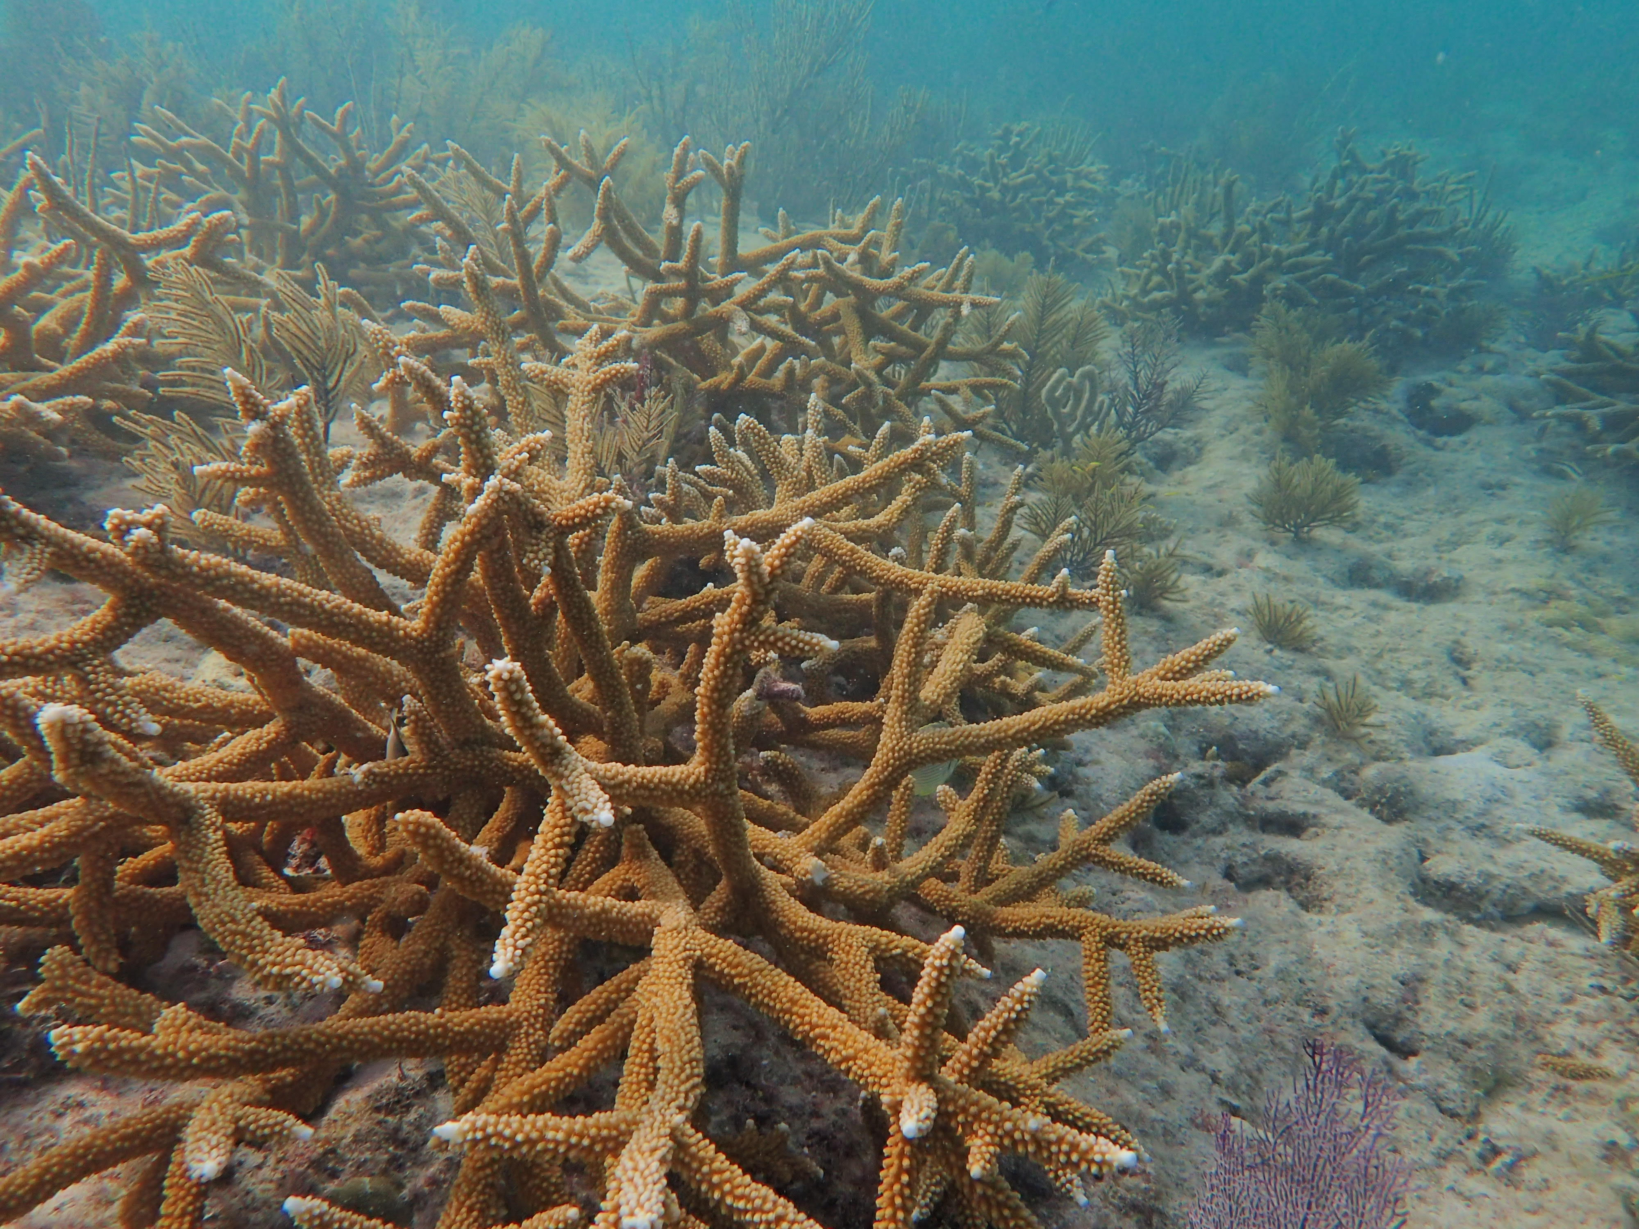
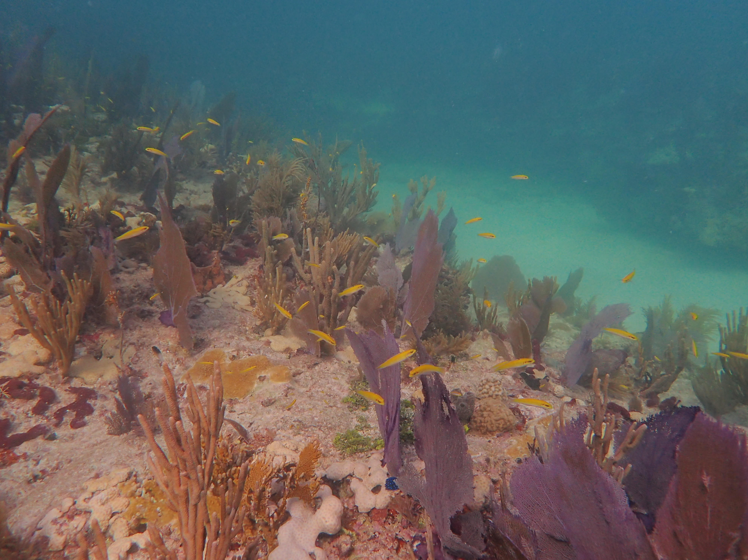
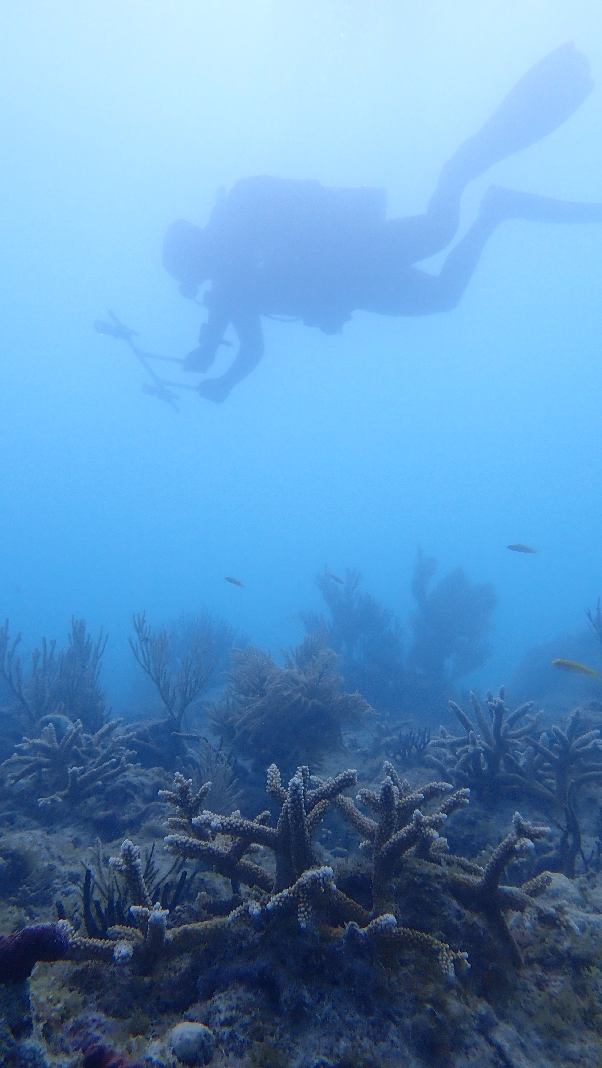
Introduction
Numerous factors severely affecting the health and diversity of the Florida’s Coral Reef
Coral Restoration is a widely accepted tool used to mitigate the damage affecting the benthic community
Photo credit: Erich Bartels
Notes:
Restoration has been established as a way to mitigate the damage and loss to the reefs -> helps restore biodiversity on multiple ecological levels

Slide 4
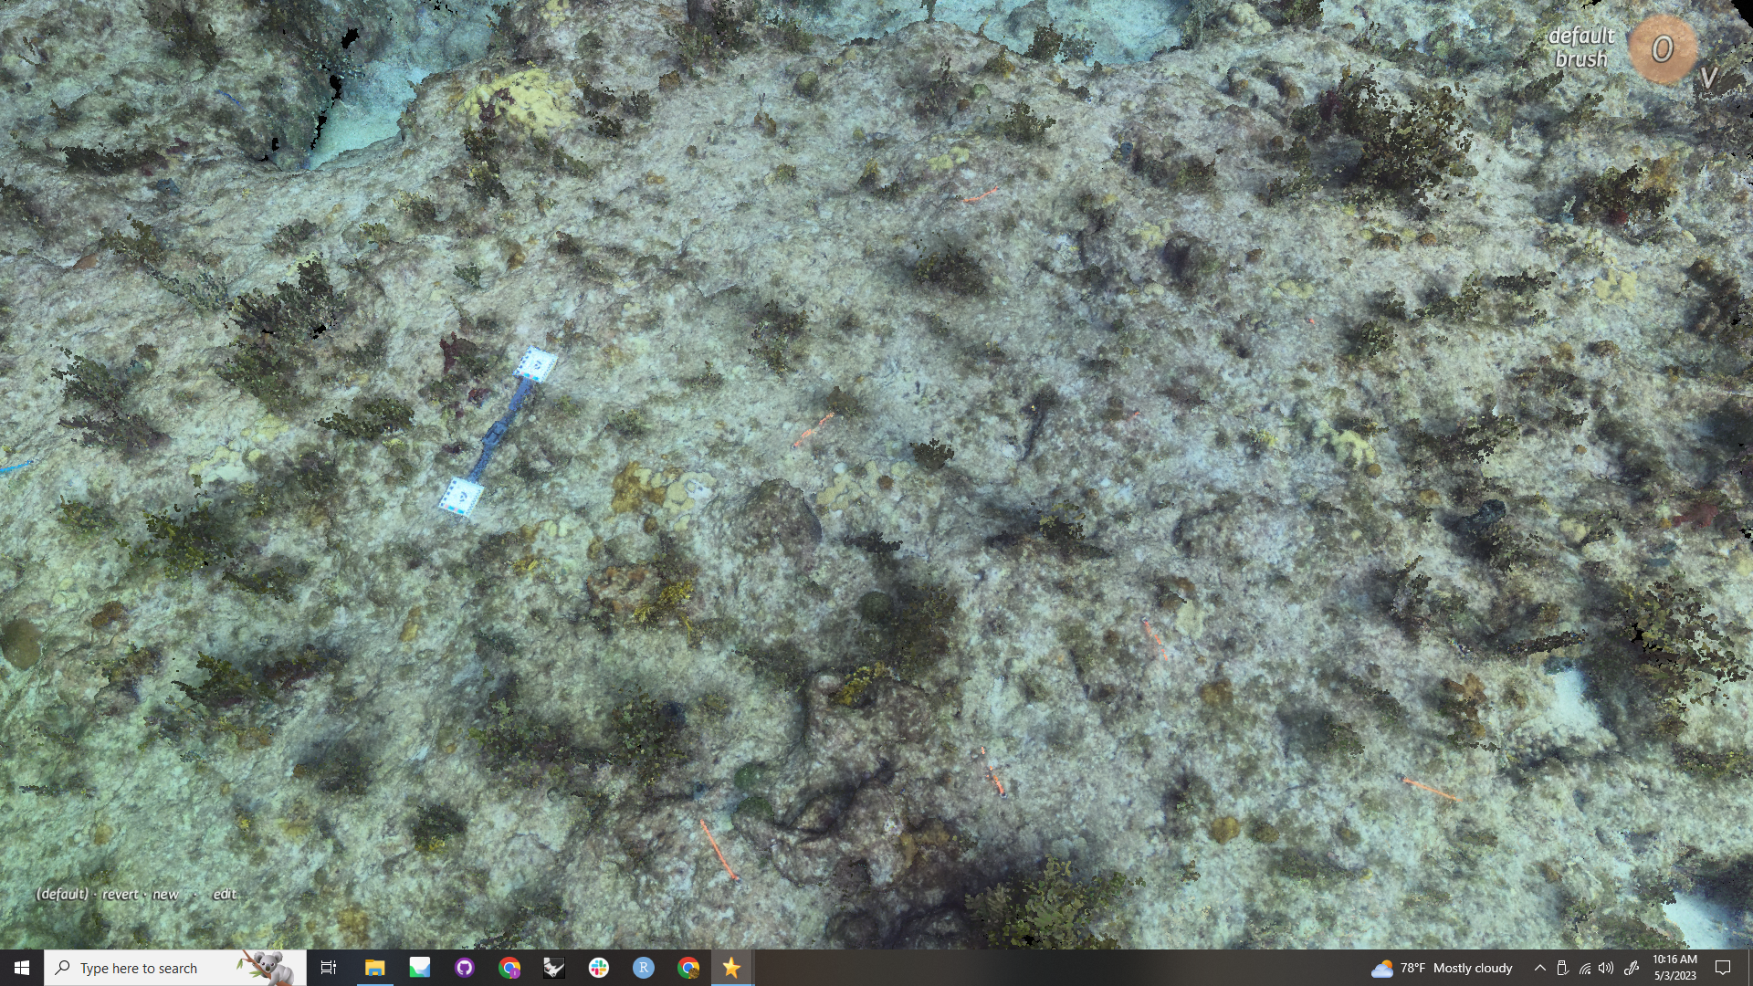
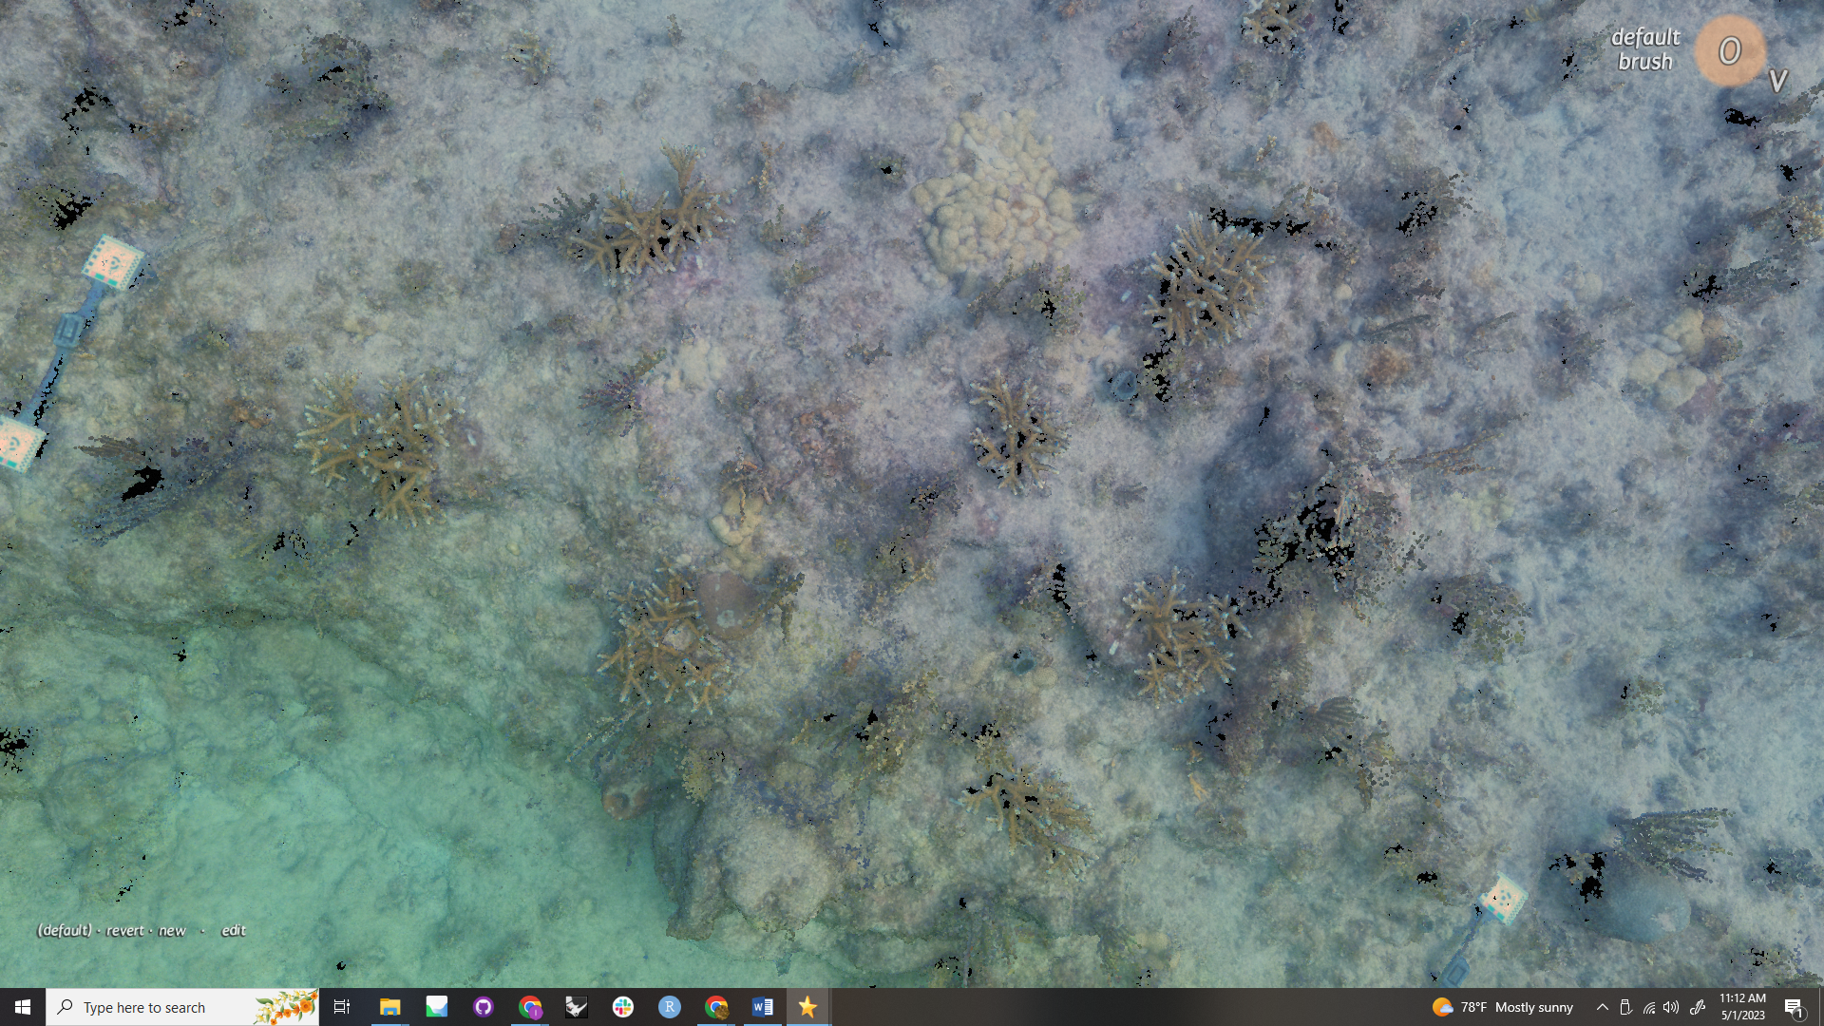
Monitoring Success
Post-restoration:
Traditionally, fate-tracking via in-water surveys used to monitor outplant success and health in the months → years after outplanting
SfM Photogrammetry has become an increasingly popular tool to compliment monitoring data
What SfM photogrammetry offers us:
Percent cover & growth metrics
Whole ecosystem assessment
Notes:
The next critical step post-restoration is monitoring those restored corals
Need to be able to quantify “restoration”
Necessary for improving methods
Also helps us gain insight into successful (or not) sites, genotypes as we “follow” them through disease/bleaching/hurricanes
Traditionally, in water colony monitoring (health of colonies)
Photogrammetry has become a useful tool to add to monitoring efforts
Sfm photogrammetry can assess, in addition, percent cover as well as growth of outplants through time

Slide 5
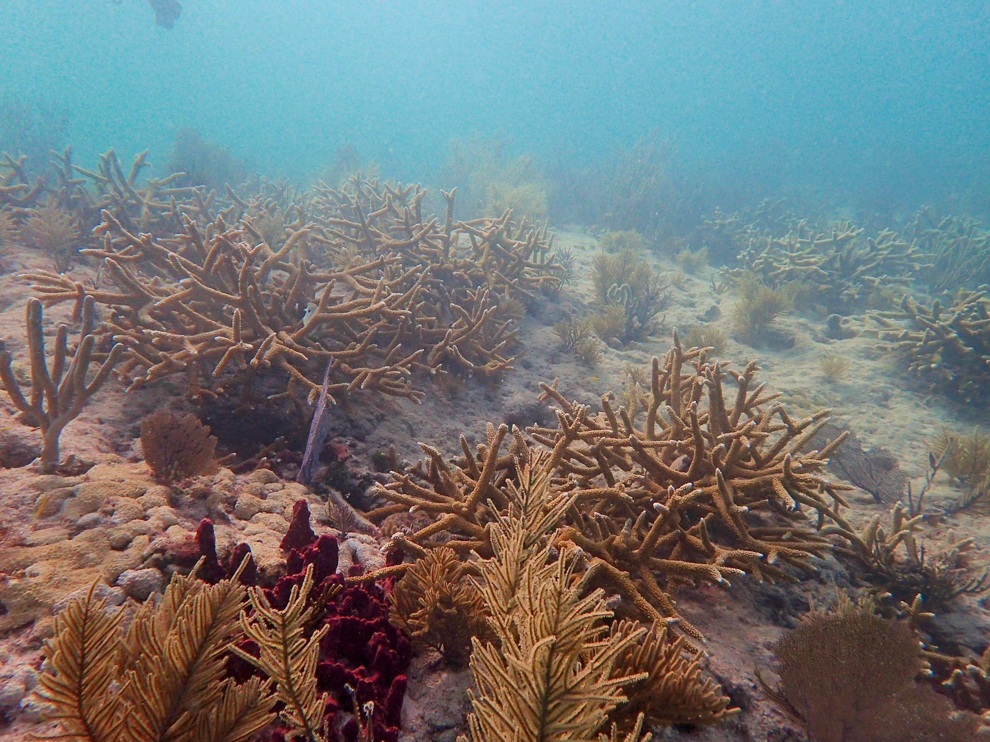
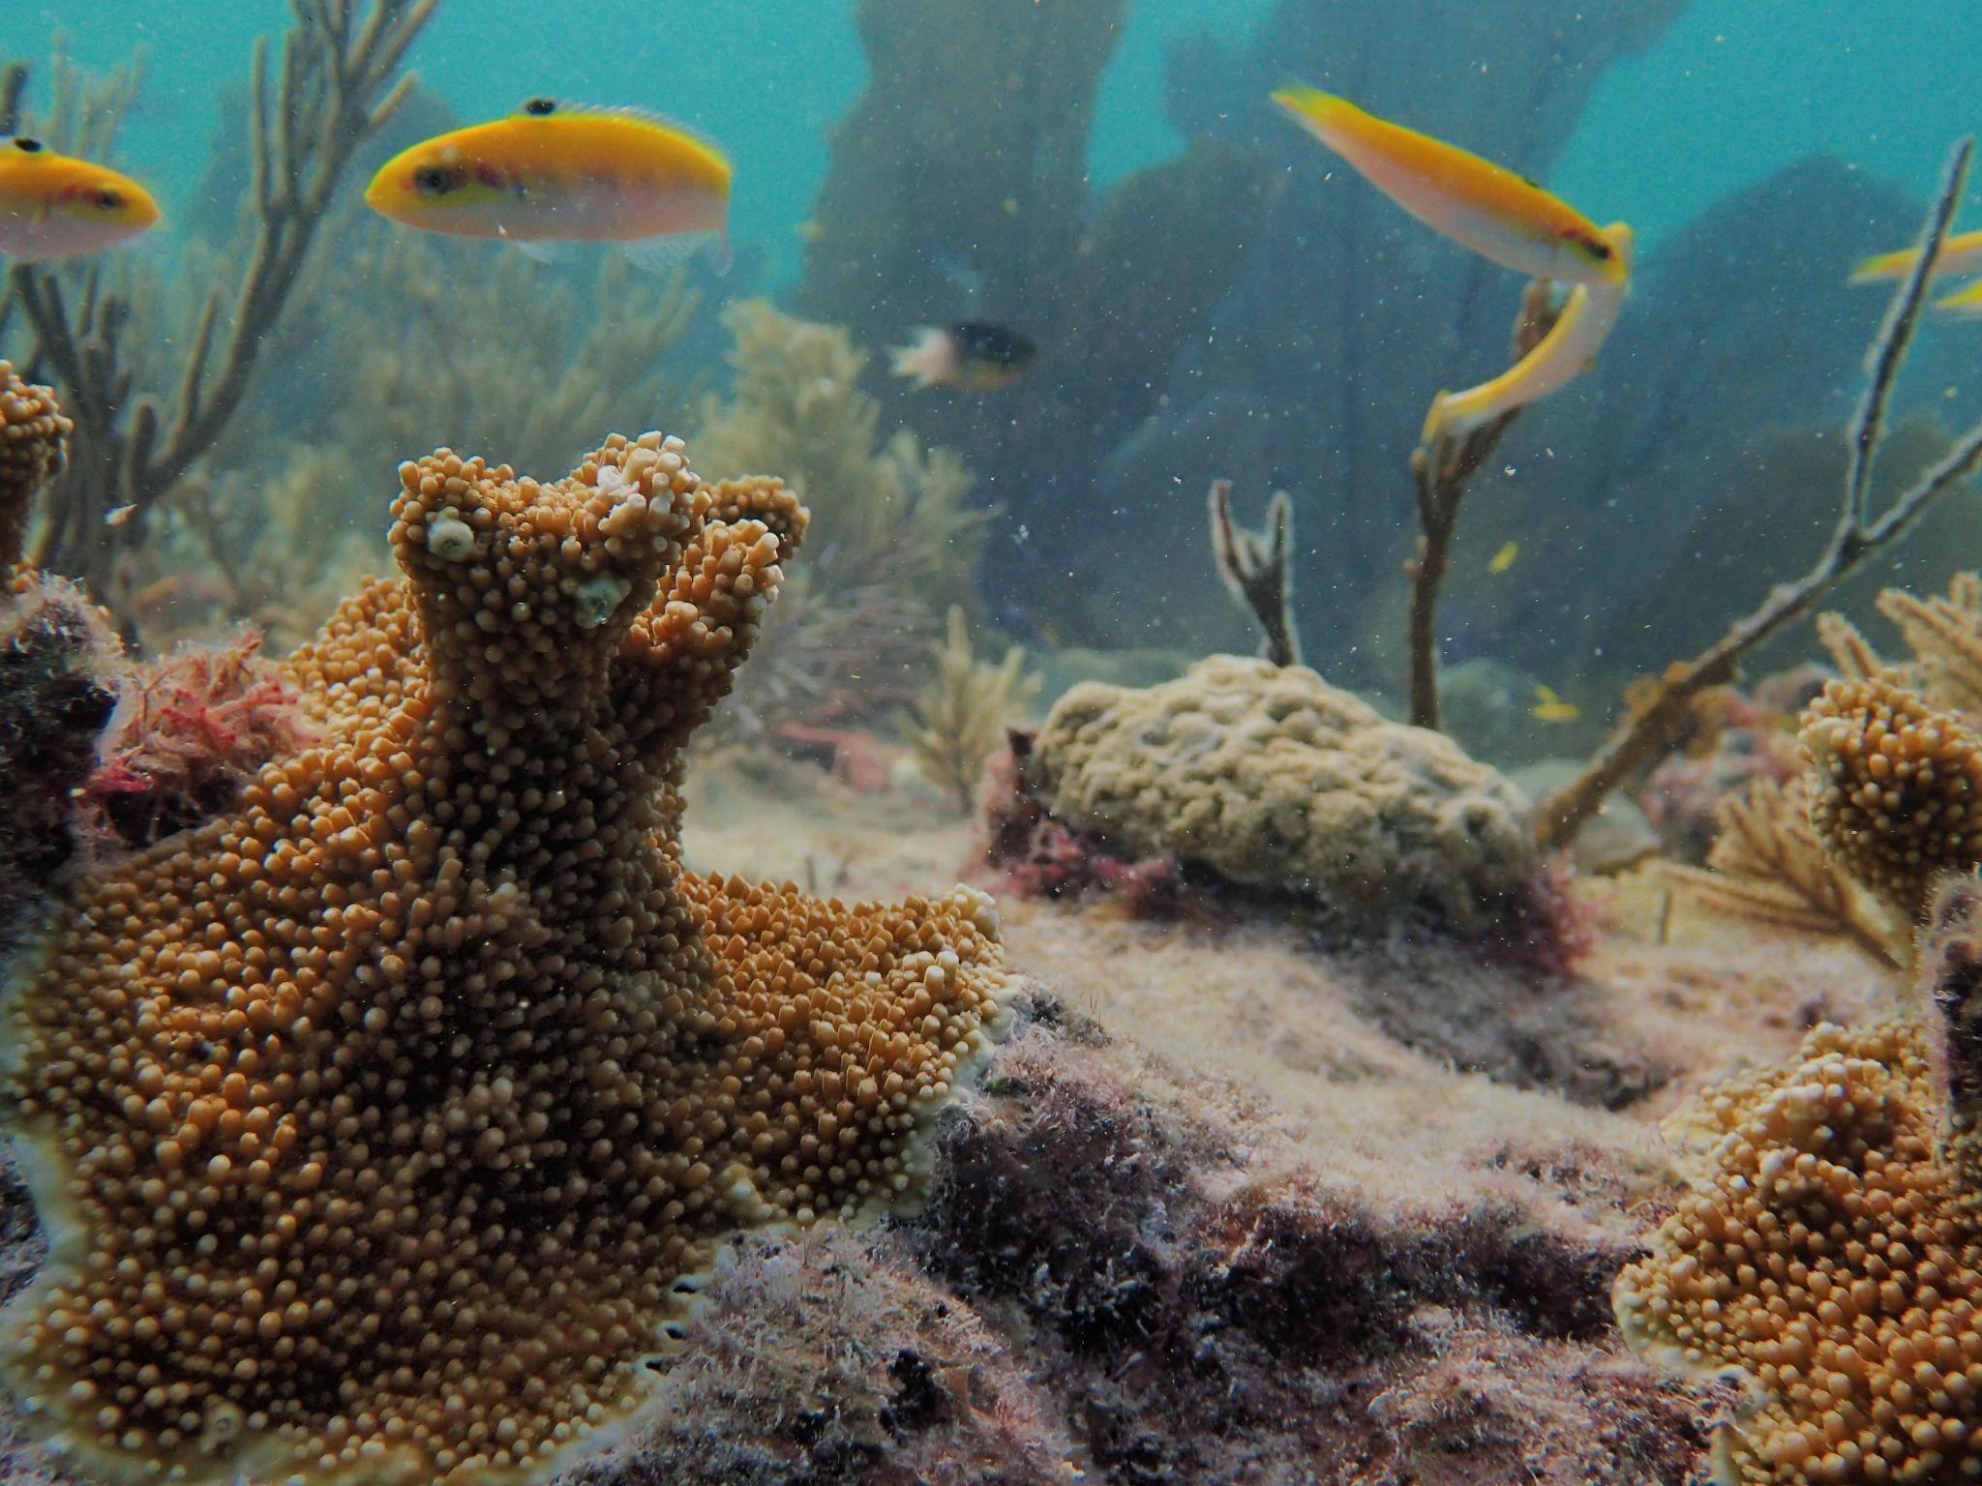
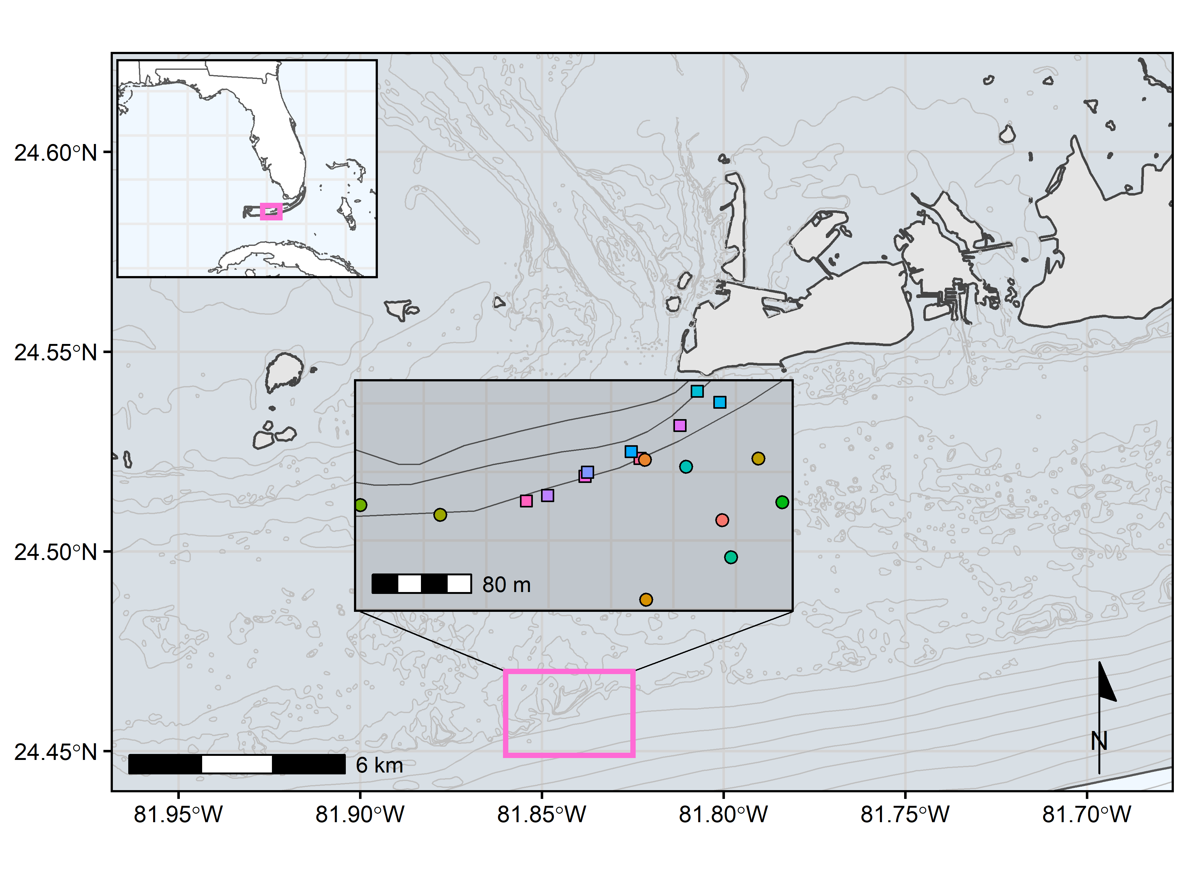
Restoration in Eastern Dry Rocks
Ongoing, long-term restoration study
To date, 40 unique sites
Imaged pre-restoration, and then annually thereafter
Outplanted with Acropora cervicornis or A. palmata
Objectives
Quantify how restoration effects the benthic community composition
Assess percent cover and biomass long-term
Eastern Dry Rocks (EDR)
Notes:
Ongoing, long-term restoration study
As of now this project consists of 40 unique reef ledges, where either Apal or Acer has been put back onto the reef
These ledges are imaged at baseline, and then annually going forwards
As of now we are entering the second year of this project, I will be presenting the first year preliminary data
Main goals of this project
Quantify composition changes in the benthic community, post-restoration through time
Measure and track percent cover and growth of outplants through time

Slide 6
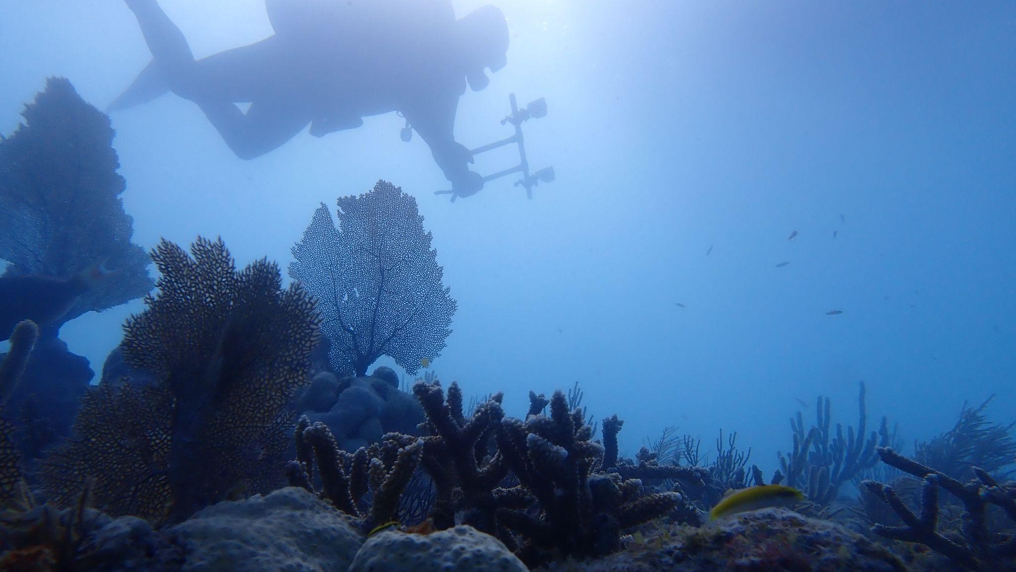
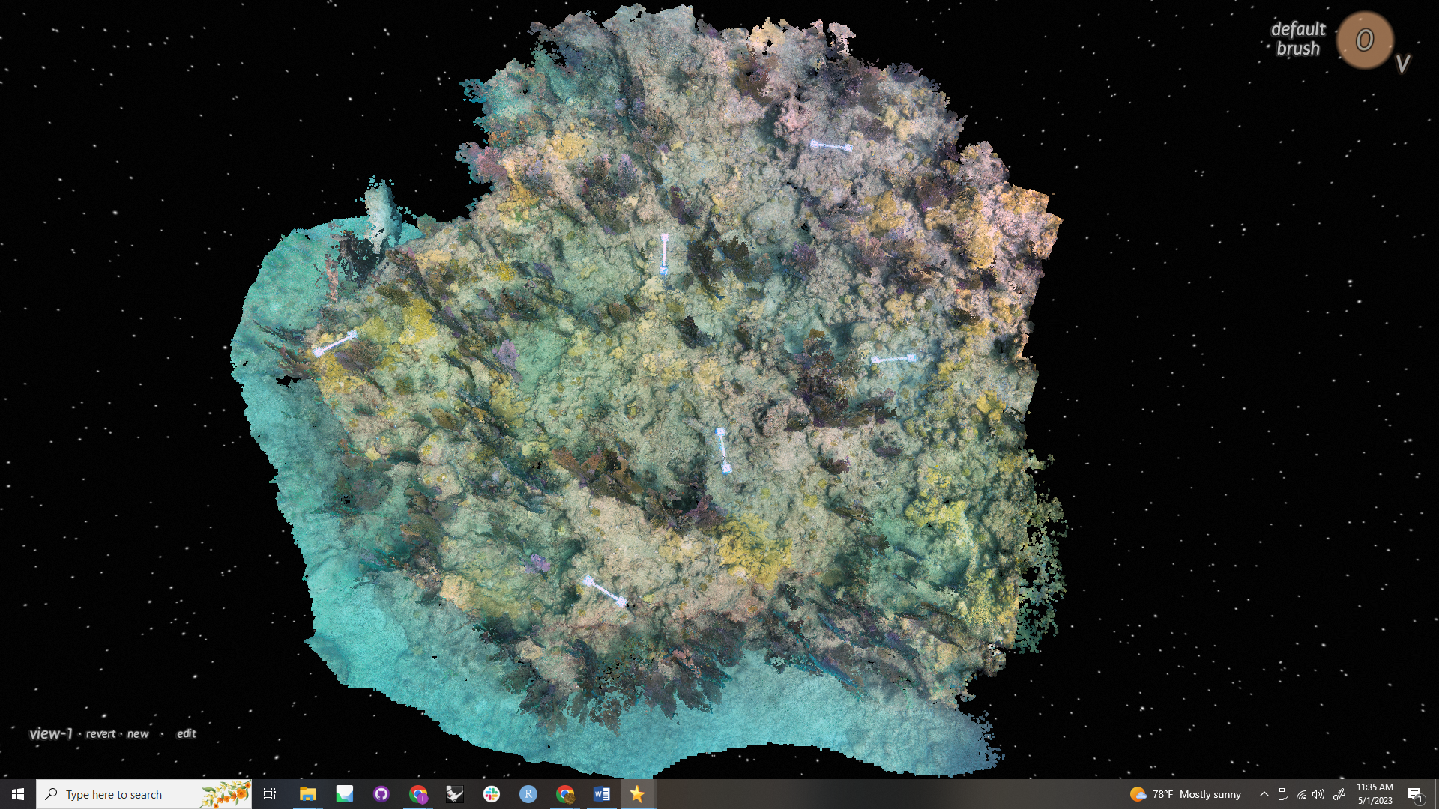
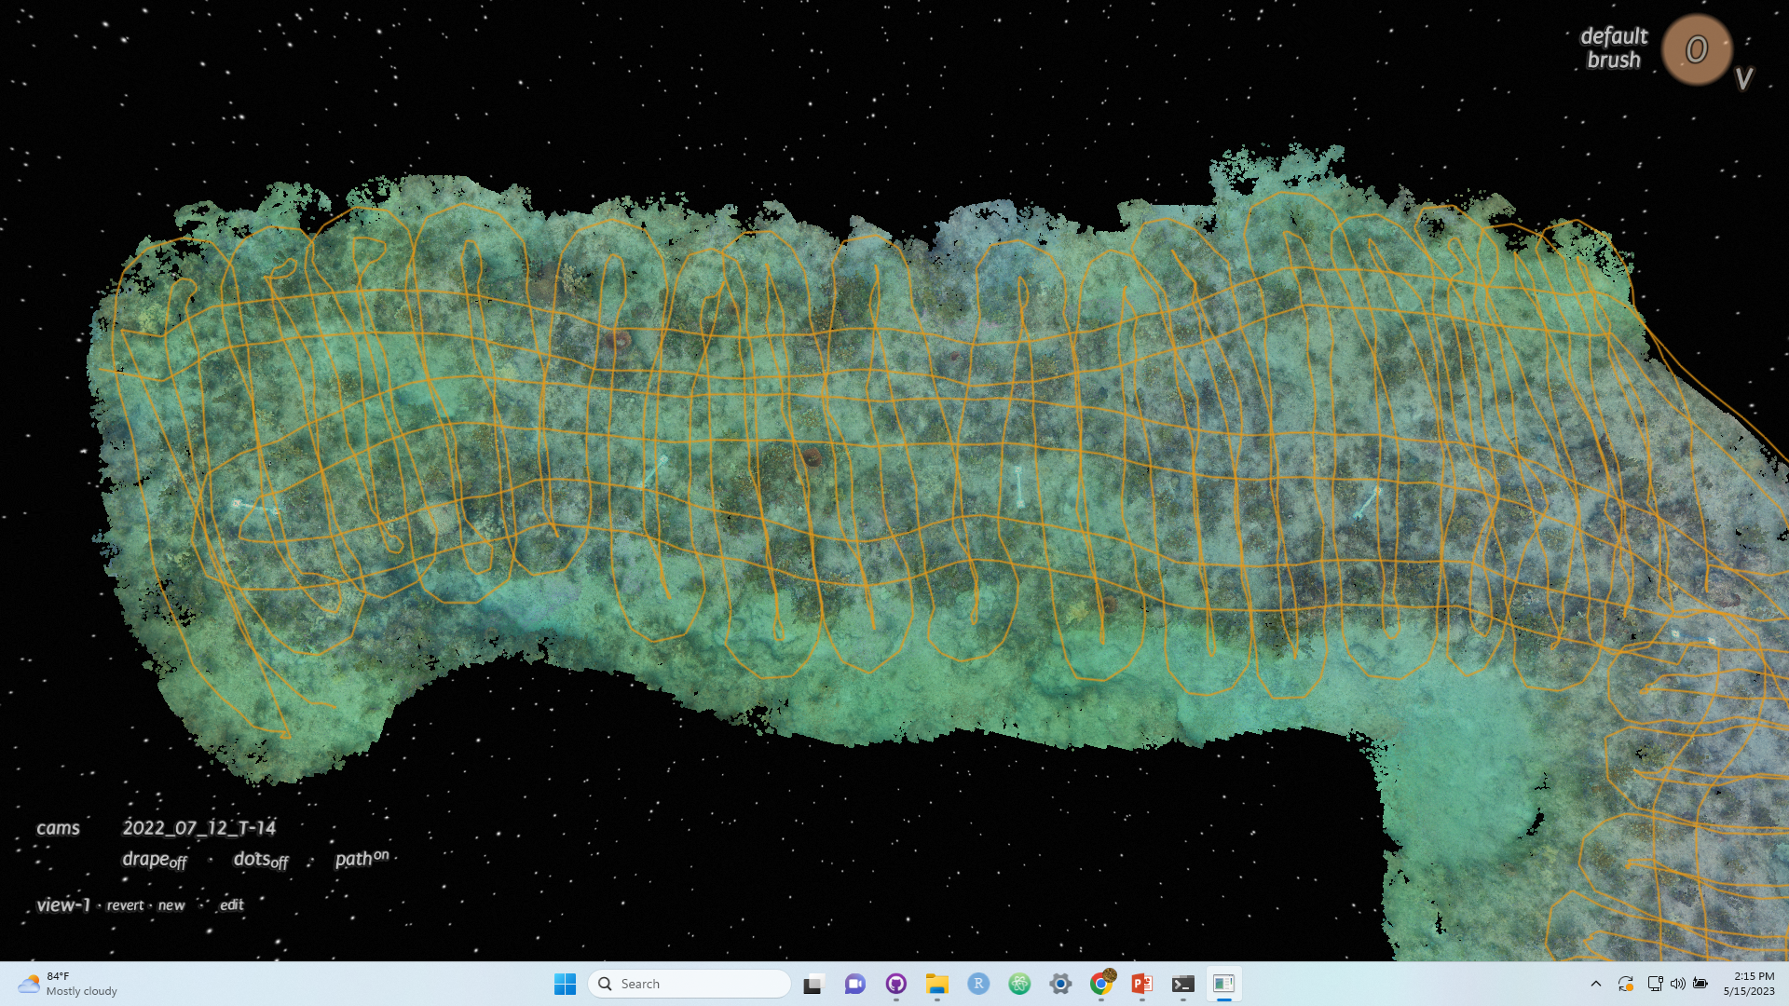
Image Acquisition
Site set-up:
Scale bars (also acting as depth markers) placed throughout site
Float markers act as temporary borders for navigational aid
Methods:
80% overlap between photos
Cameras capture 1 image/second
Swim path akin to modified lawnmower pattern
Cameras:
Two GoPro 10s set 60cm apart on a PVC rig
Photo Credit: Erich Bartels
Notes:
Once we get to the site, we prep by laying out scale bars (which double as depth markers) throughout.
Where natural barriers don’t exist (such as spurs or reef ledges) floats are placed to mark boundaries
Assists in navigation
For this project, the cameras used are two gopro 10s set 60 cm on a pvc rig
For the images themselves, 80% overlap between photos is ideal
Conditions can make this harder to achieve at times
1 photo per second
Swimming at a slow enough pace, with the passes close enough to get around the right overlap
Swim pattern can be described as a modified lawnmower, with short passes having ideal overlap, with a few passes in the perpendicular direction
Helps make sure there is no reprojection error (warping or inaccurate 3D generation)

Slide 7
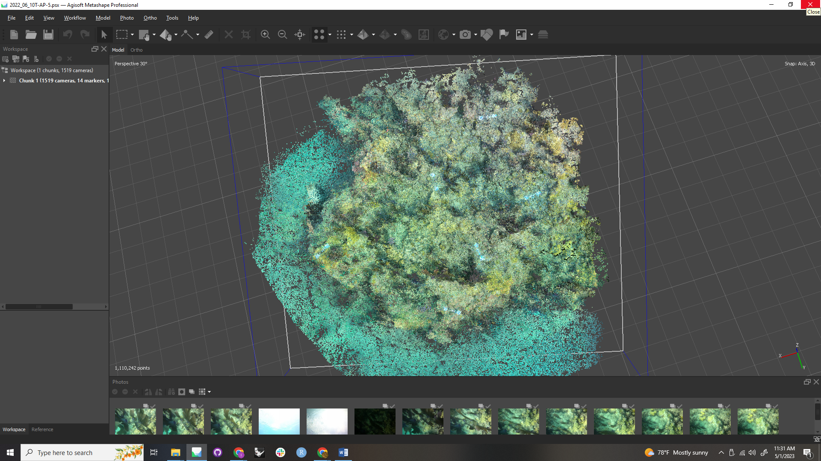
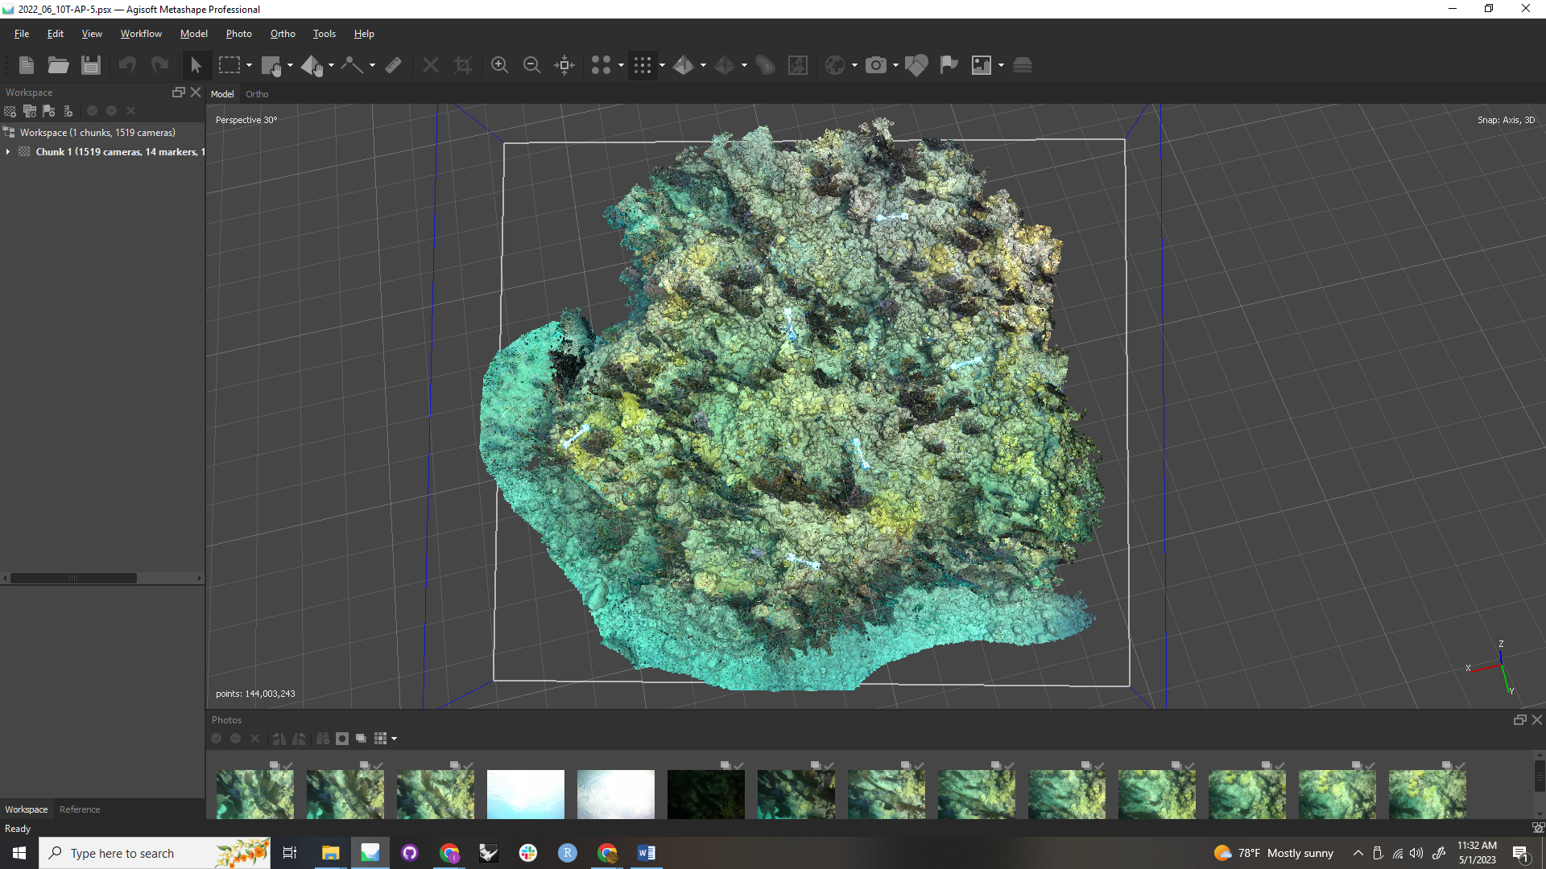
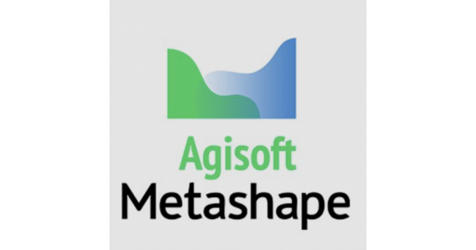

SfM Photogrammetry
Three-dimensional information is derived from sequences of two-dimensional images
Image alignment
Dense cloud generation
Data extraction
Viscore
Notes:
Once the imagery has been taken in the manner described, we use agisoft metashape (which is a software able to process 2D images to generate 3D spatial information)
First generated is the sparse cloud made of points extracted from the alignment of photos
The dense cloud can then created from the rectification of sparse-cloud points
This product can then be exported for further annotation

Slide 8
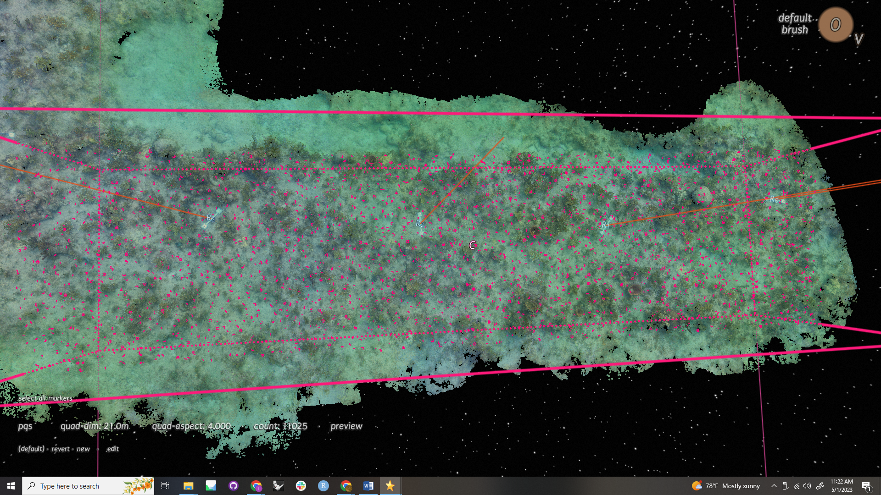
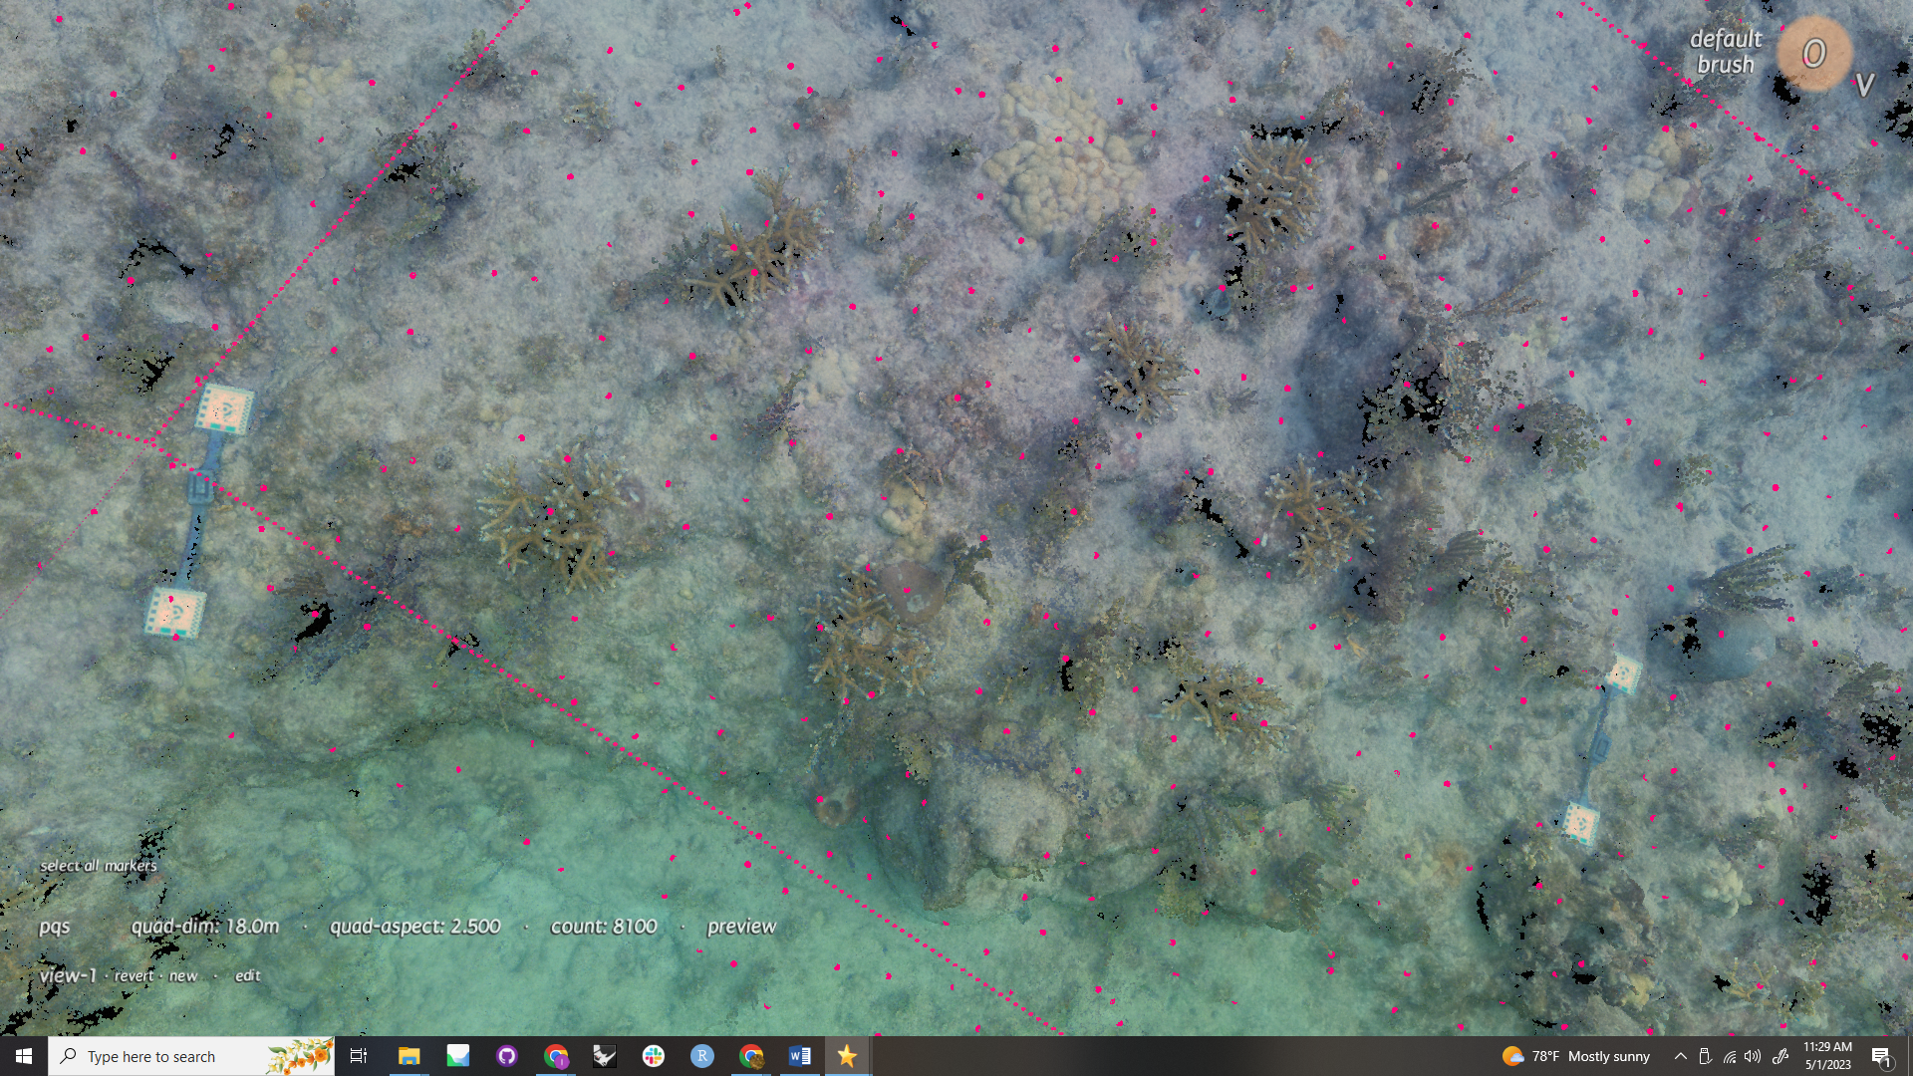
Data Collection
Benthic community composition
Viscore
Software platform which allows for interaction with 3D visual products
Imagery is scaled and oriented
Visual Point Intercept (VPI) survey; automated distribution of randomized points at target density
Points are linked to raw imagery for identification
Notes:
The first steps in the analysis of our models takes place in Viscore, a point-based analytics software, that allows for the interaction with 3D data
Models are scaled and oriented with what was collected in the field
Then visual point intercept (vpi) surveys are done, essentially a working area within a model can be set, and with the desired point density set, the program will randomly generate points throughout.
we use a density of 25 points per m2

Slide 9
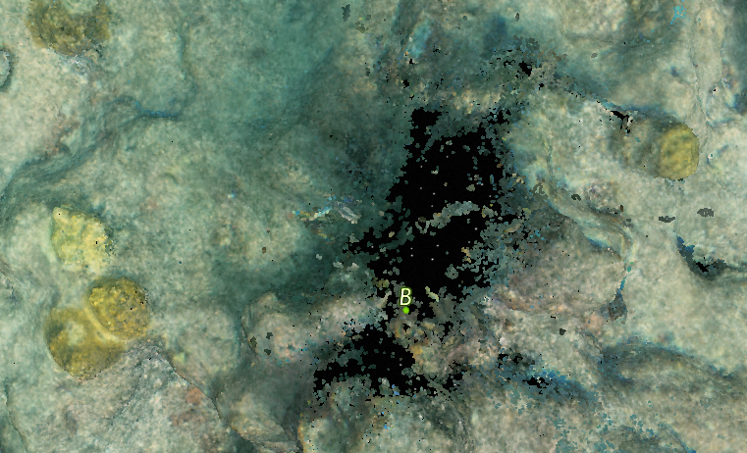
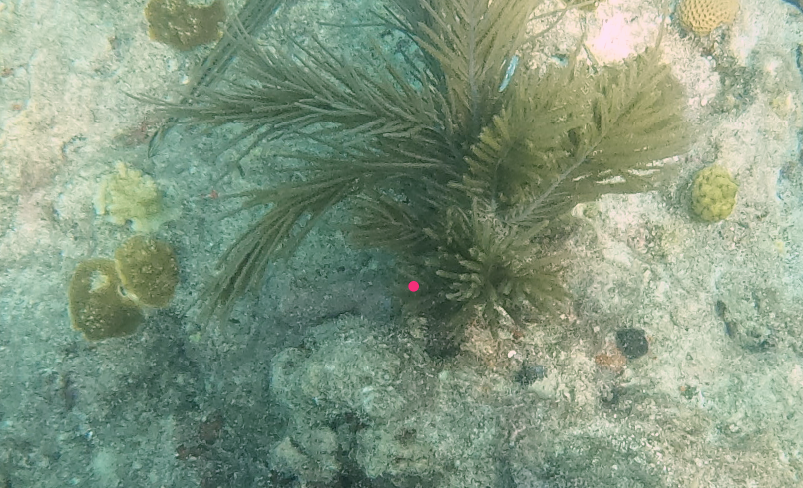
Data Collection
Benthic community composition
Viscore
Software platform which allows for interaction with 3D visual products
Imagery is scaled and oriented
Visual Point Intercept (VPI) survey; automated distribution of randomized points at target density
Points are linked to raw imagery for identification
Point Cloud
Raw Imagery
Notes:
something really helpful, the points generated, as well as any point placed on the model, is linked to the raw imagery
makes identification much easier and can account for gaps in the model

Slide 10
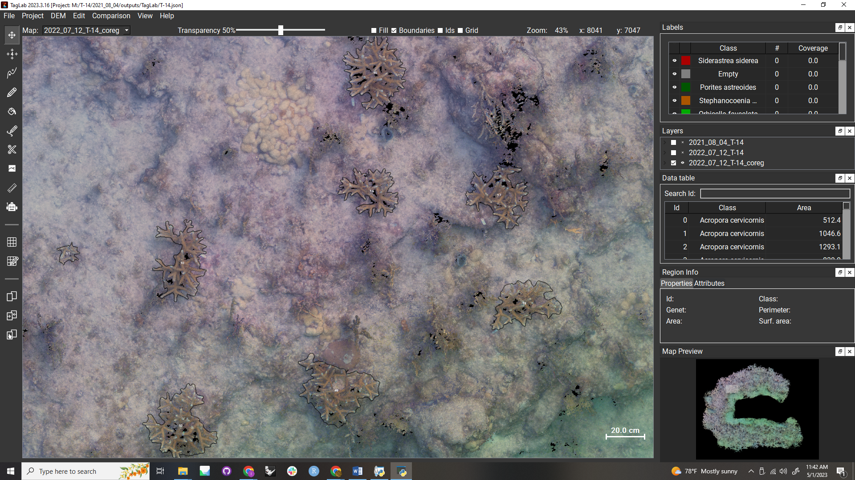
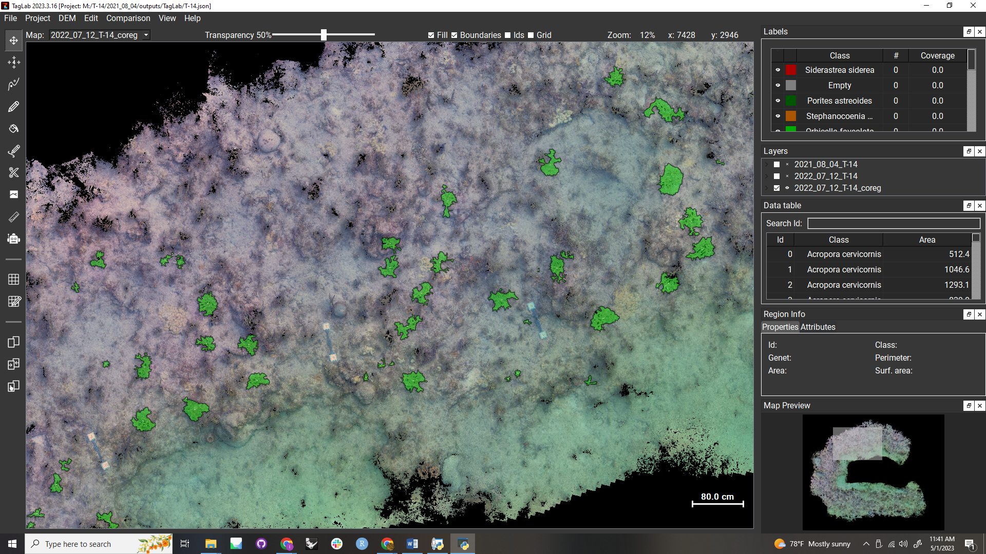
Data Collection
Percent cover and growth over time
TagLab
AI-powered 2D segmentation software
Combination of semi-automatic and manual tools
Accurate representation of the distribution of 2D reef space between organisms
Automatic segmentation/classifier tool can be trained to fit different species/reef types
Despite automation, continues to keep human “in the loop”
Notes:
The other main software were using for analysis in this project is TagLab, an AI-powered software capable of supporting orthographic images and their analysis
Models are turned back into 2D products (orthoprojections) before being exported for segmentation (tracing)
Both semi-automatic and manual tools can be used to outline the target species (in our case just corals outplanted)
Gives us surface area by category as well as growth of individual colonies over time with the capability of linking colonies from two different orthos
Taglab also has machine learning capabilities -> ability to teach it to automatically recognize, trace, and classify different benthic species
However, there are characteristics and densities hat make some sites more ideal than others for the training and success of this tool

Slide 11
VPI Data
sp.

Slide 12
data/discussion

Slide 13
Future directions?

Slide 14
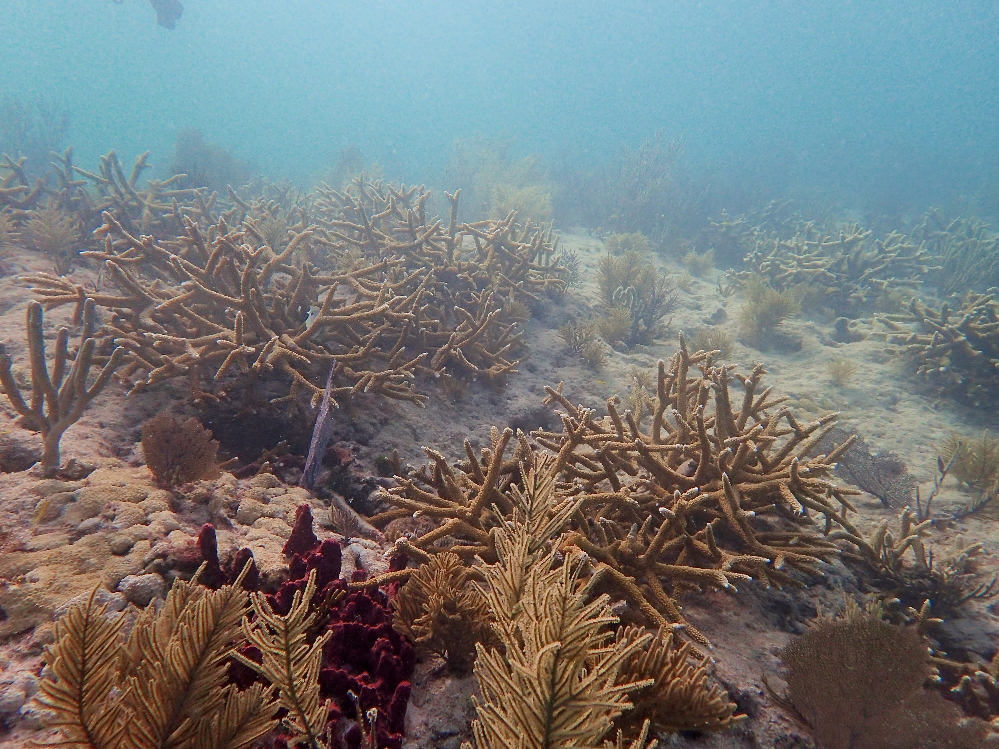

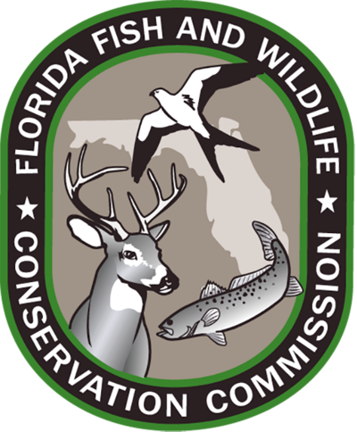



Acknowledgements
Zachary Craig
Dakotah Merck
Summer Brooks
Megan Kennedy
Gloria Keough
Sarah Hamlyn
Joseph Kuehl
Cory Walter
Samantha Simpson
Kyle Knoblock
Ryan Bonhag
Brooke Pohlman

